Slide 1
Meeting Outline
Open-loop data generation of system with MSD
  Only standstill multisine excitation
    8 total
      6 training
      2 validation
Open-loop augmentation training
  Linear encoder init
  baseline + ANN
Training with controller

Slide 2

Baseline model

Slide 3

System for data generation

Slide 4

Augmentation
Overview
Notes:
Kijken gaug is dat augmented states?

Slide 5
Training Trajectories

Slide 6
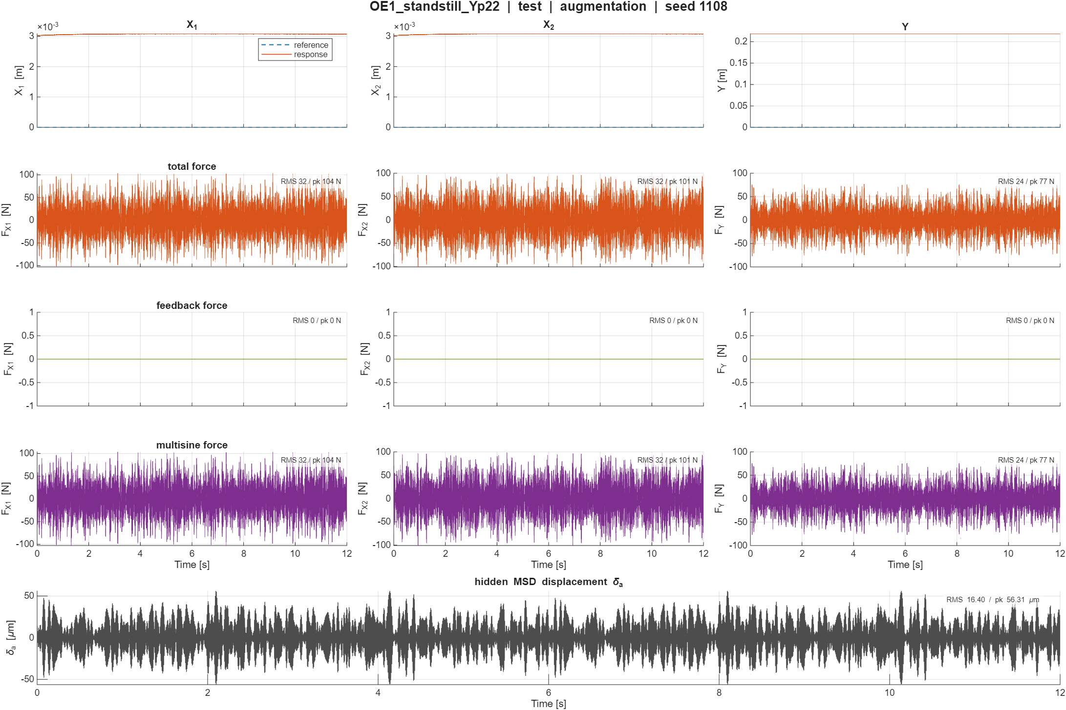

Slide 7
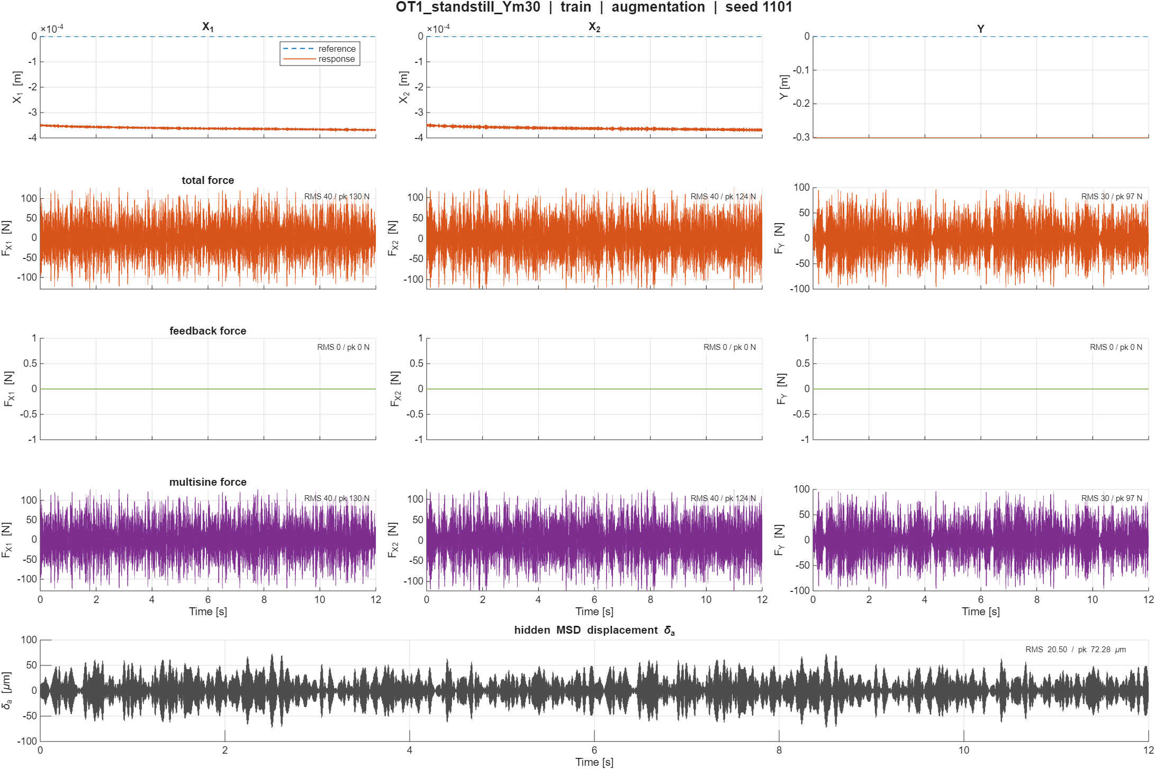

Slide 8
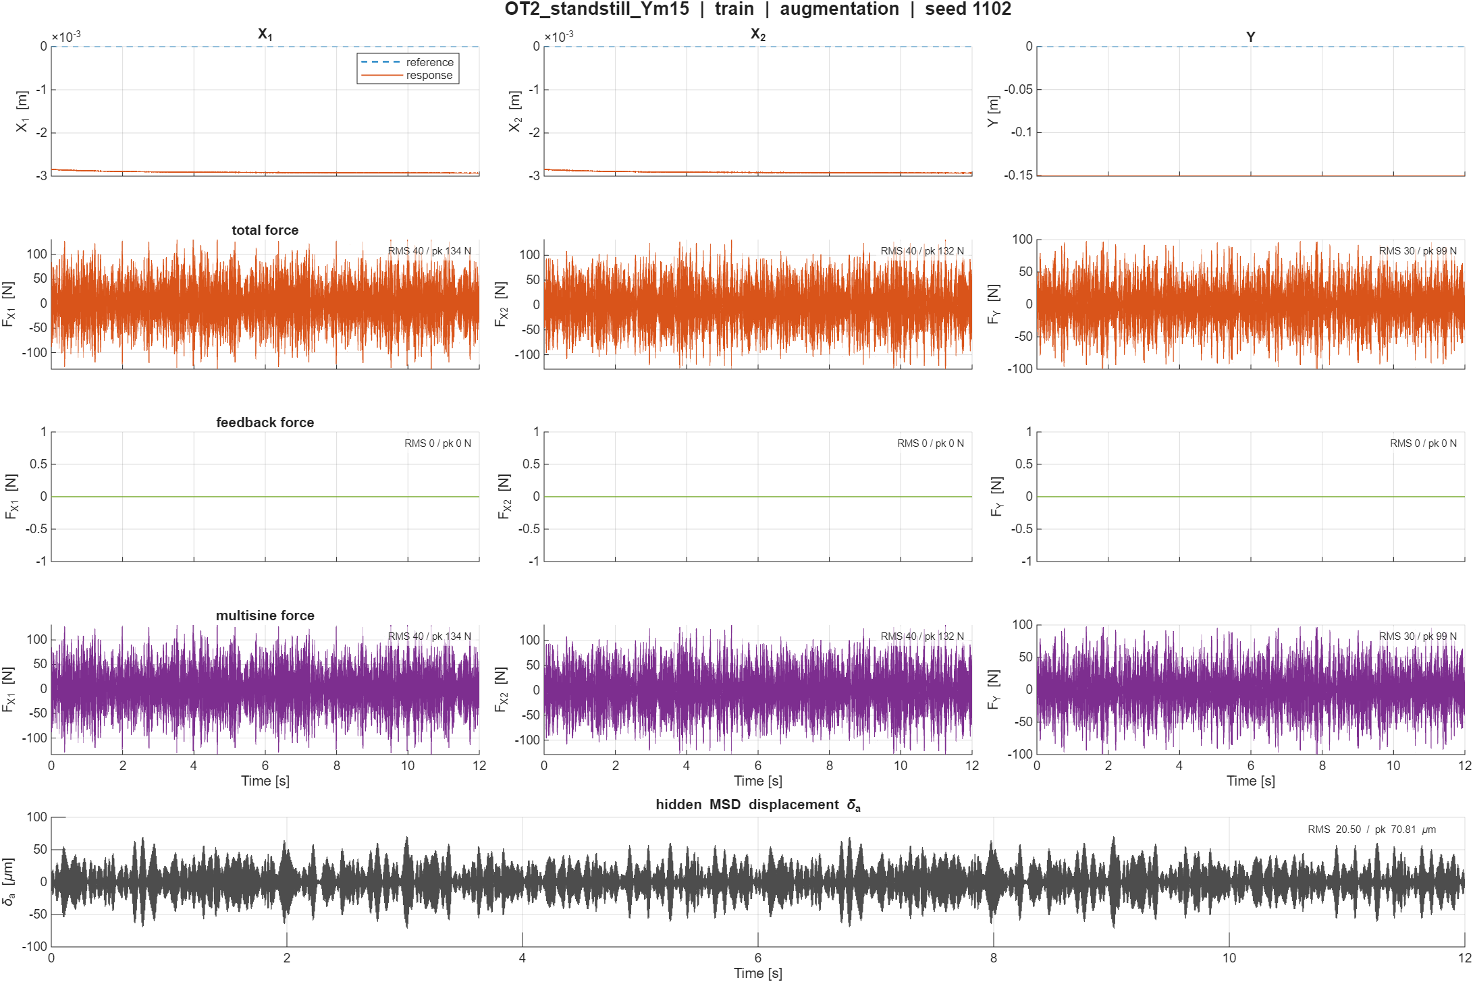

Slide 9
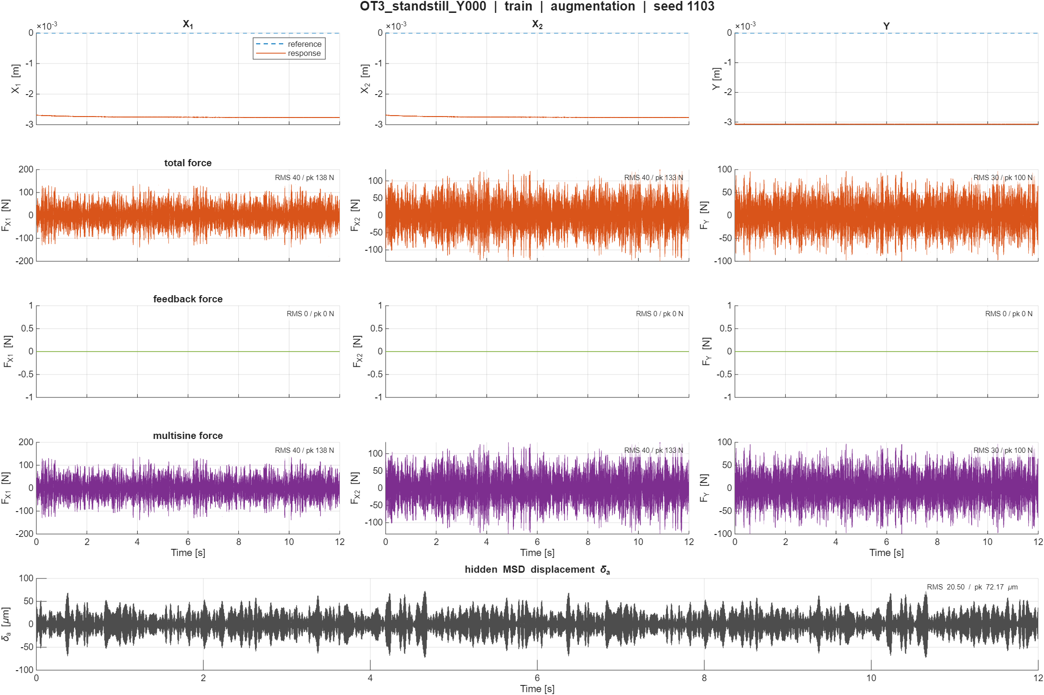

Slide 10
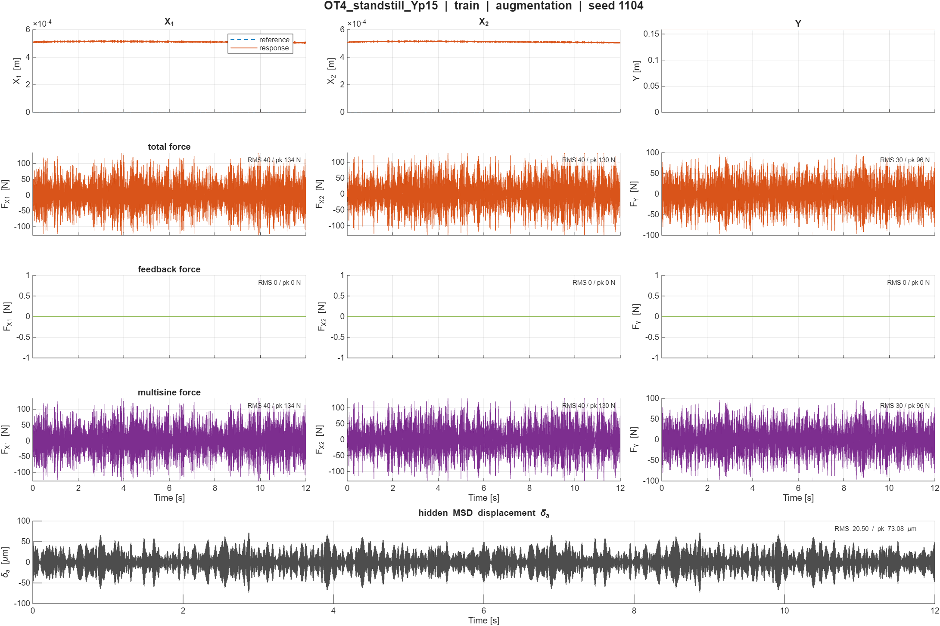

Slide 11
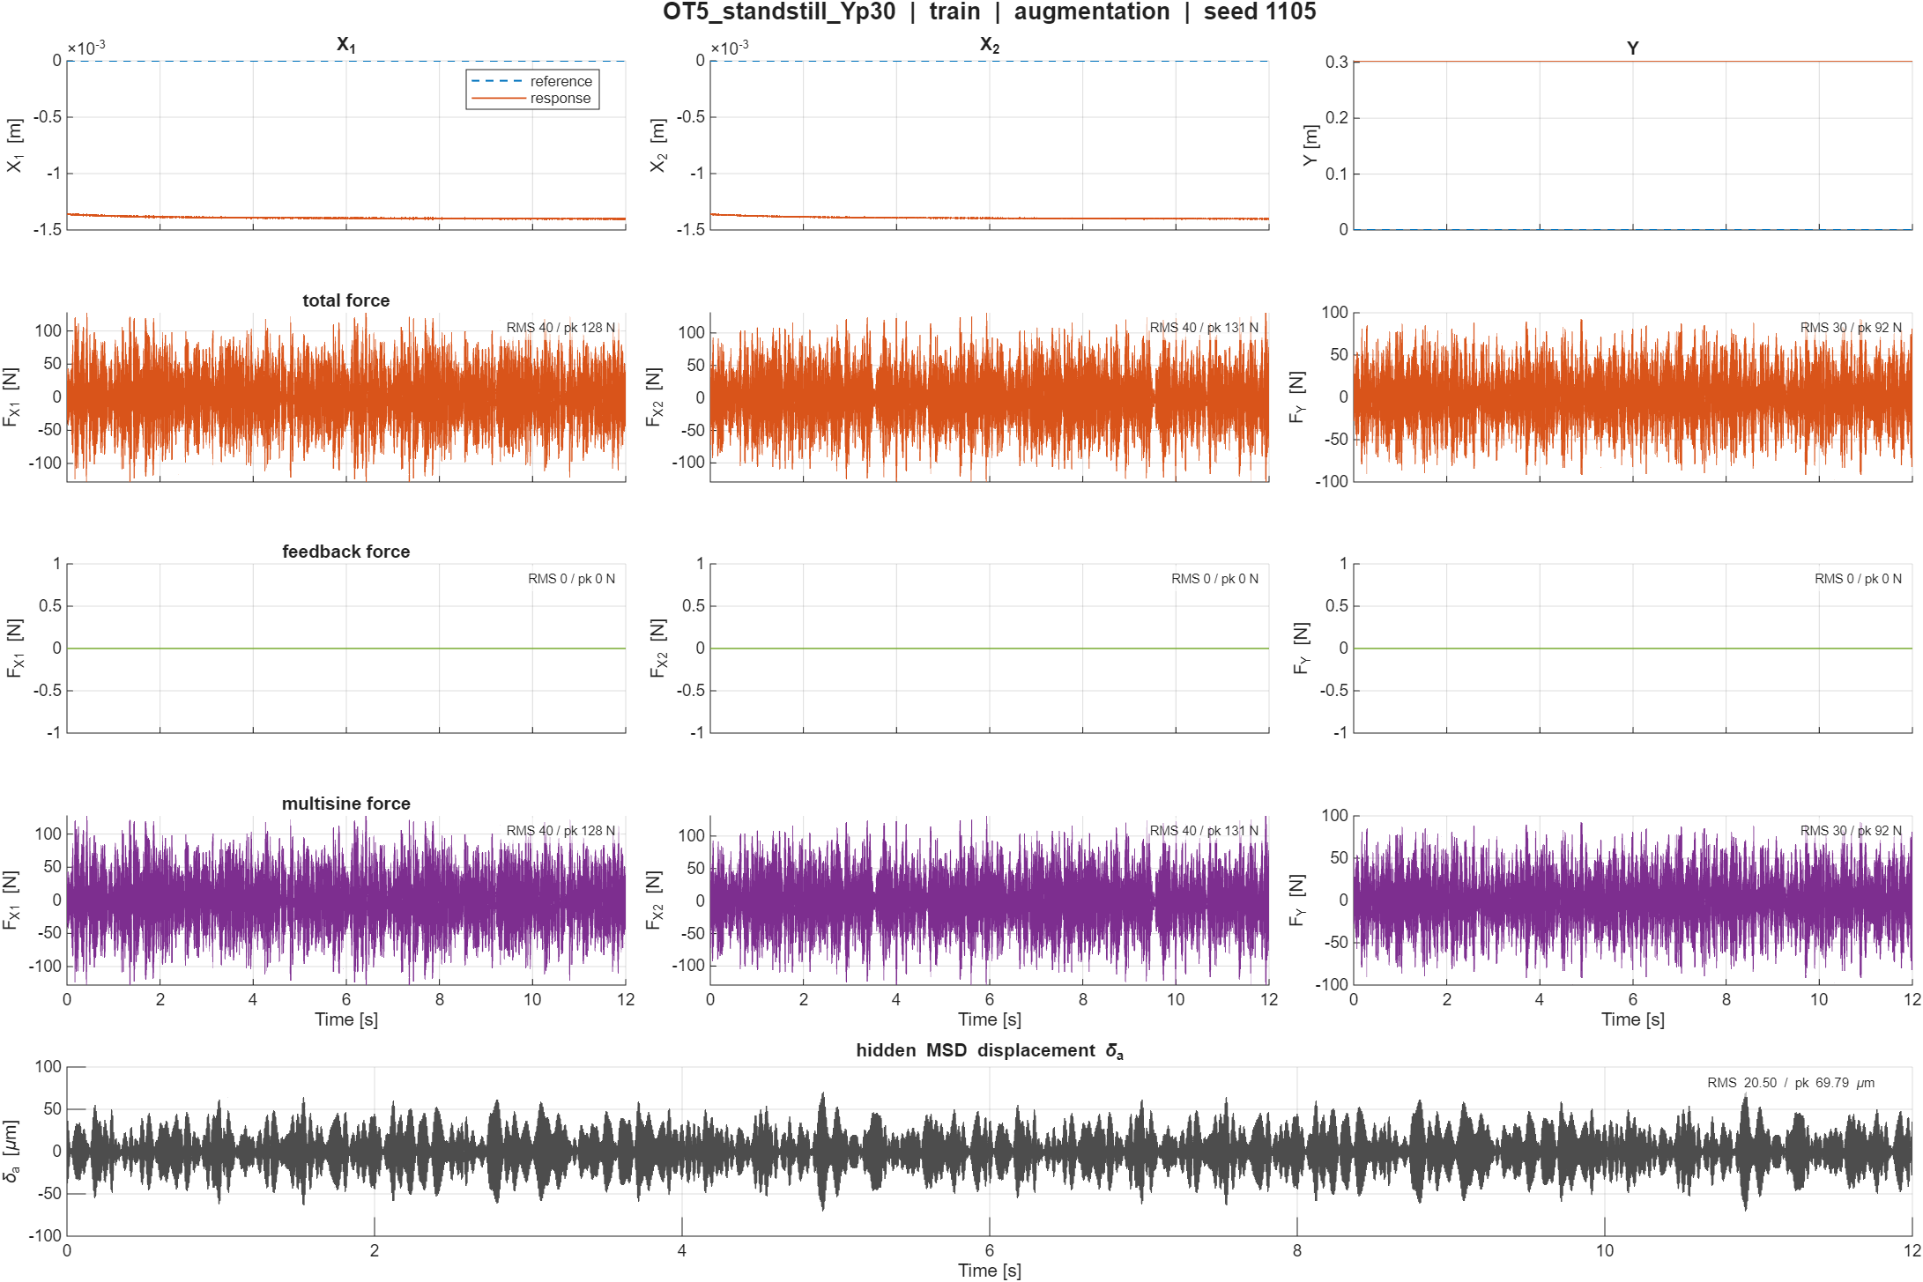

Slide 12
Validation Trajectories

Slide 13
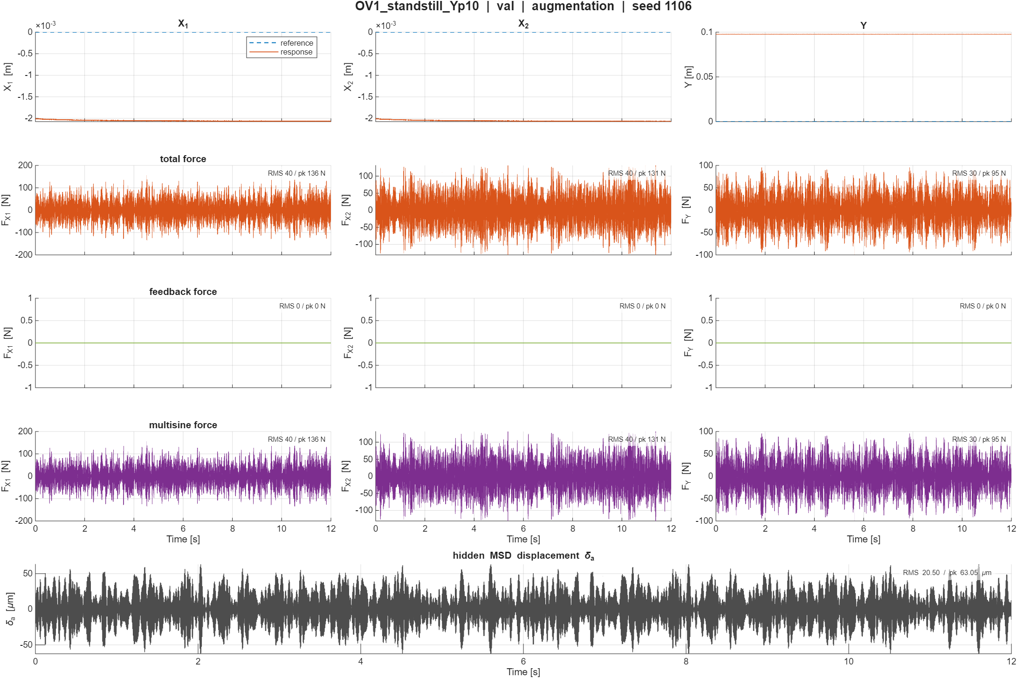

Slide 14
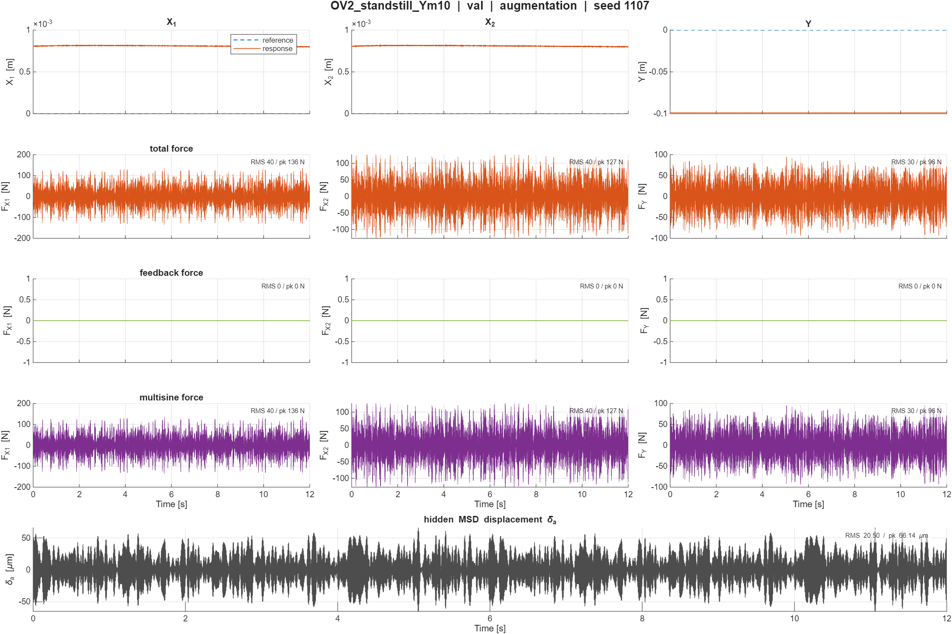

Slide 15
Replay open-loop
System data recorded in open-loop
All standstill
No reference because only input now without controller

Slide 16
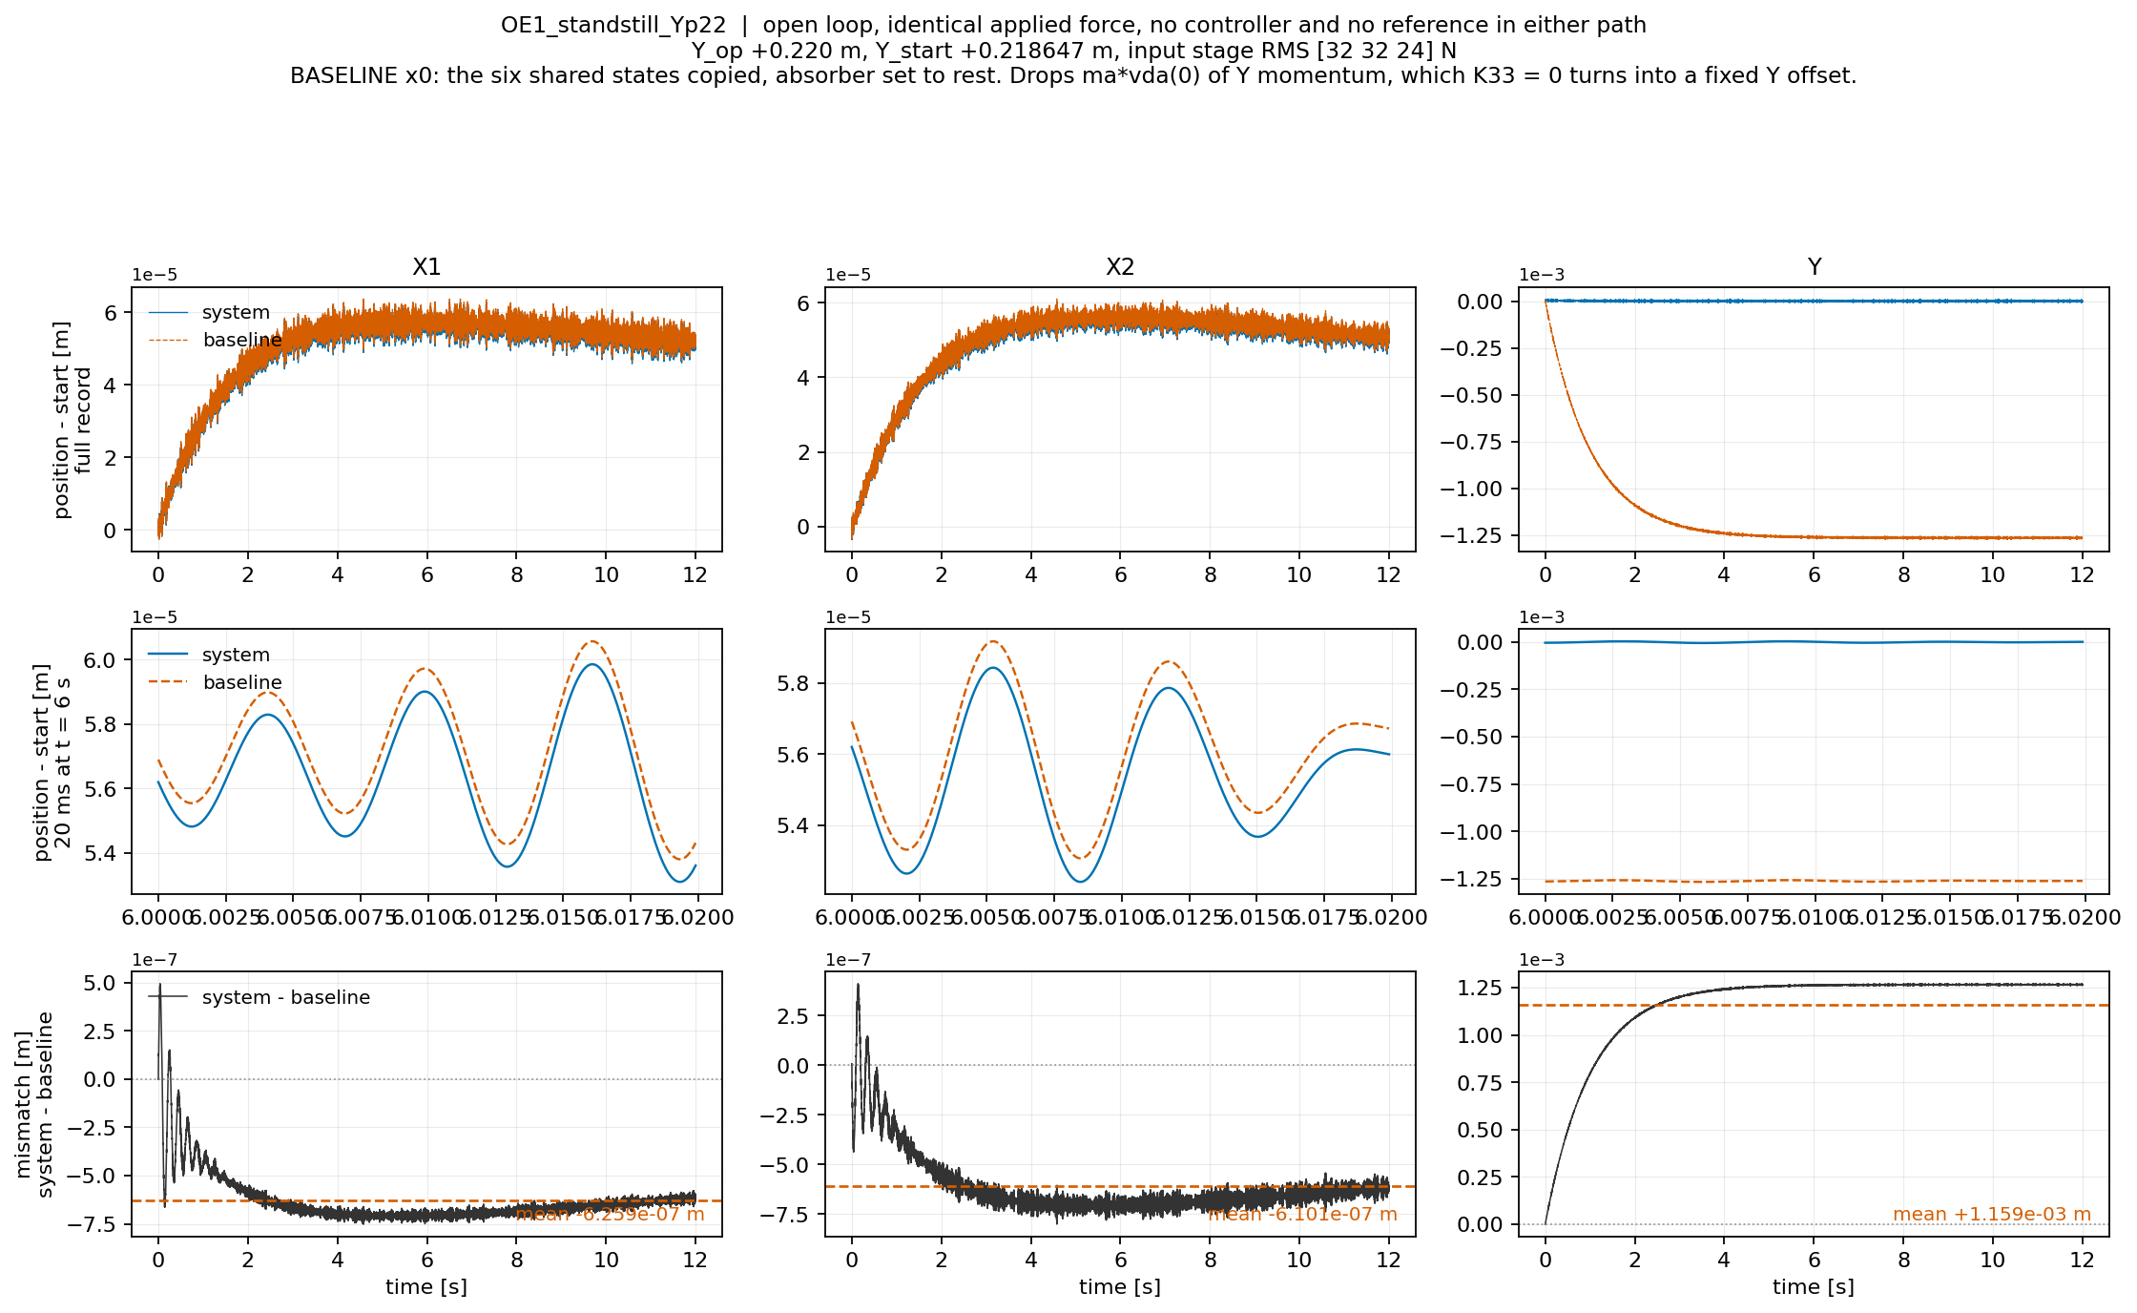

Slide 17
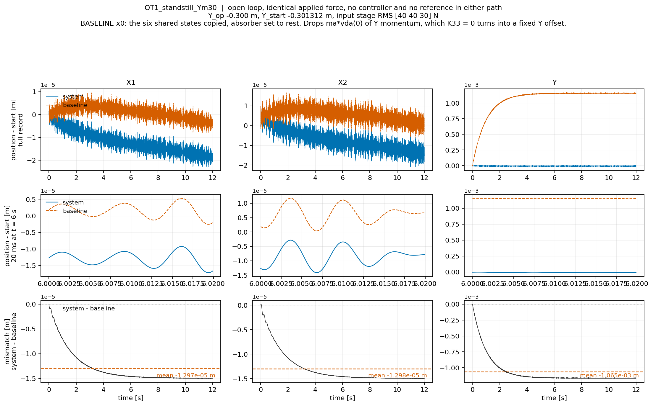

Slide 18
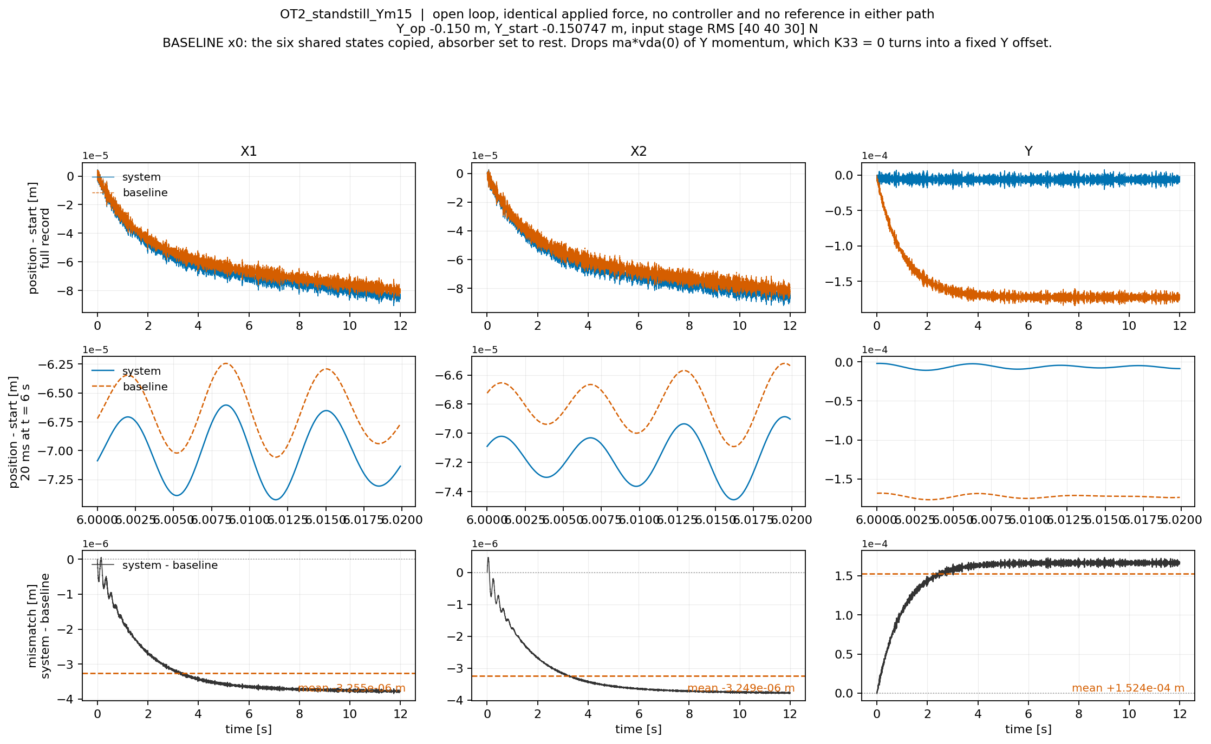

Slide 19
Add momentum of absorber
For dY add the momentum of the absorber
  Both models carry the same 10.1 kg payload. The system splits it into a rigid part and a 1.01 kg absorber; the baseline keeps it as one rigid mass.
  Seeding the baseline with the shared states matches position and payload velocity, but not the absorber's momentum.
  Y has damping cy but no stiffness (K33 = 0). With no restoring force, the excess momentum can only travel through the damper.
  → Result: a fixed position offset
This is what the augmentation needs to learn
  Mismatch due to absorber absent
Notes:
, dY = ma * vda(0) / cy

Slide 20
seeding
To draw the baseline curve I have to integrate the 6-state model forward from somewhere. The record stores the system's 8-state initial condition, [X, Th, Y, da, dX, dTh, dY, vda]. The baseline has only six of those states, no da and no vda, because it has no absorber.The obvious thing, which is what I did first, is to copy the six states they share and drop the other two. That is wrong in a specific way. The absorber is a mass ma = 1.01 kg moving at vda(0), which at the record's first sample is up to 0.043 m/s. That is real Y momentum, ma * vda(0), and dropping the state drops the momentum with it. The baseline starts physically lighter in motion than the system it is being compared to.Normally a small momentum error would decay. Here it cannot: K33 = 0, Y has damping but no stiffness, so there is no restoring force and the momentum difference converts into a permanent position difference of ma * vda(0) / cy. With cy = 10 Ns/m that is millimetres, against a real model discrepancy of 2e-06 m. So the panel was showing my choice of initial condition, three orders larger than the physics.

Slide 21
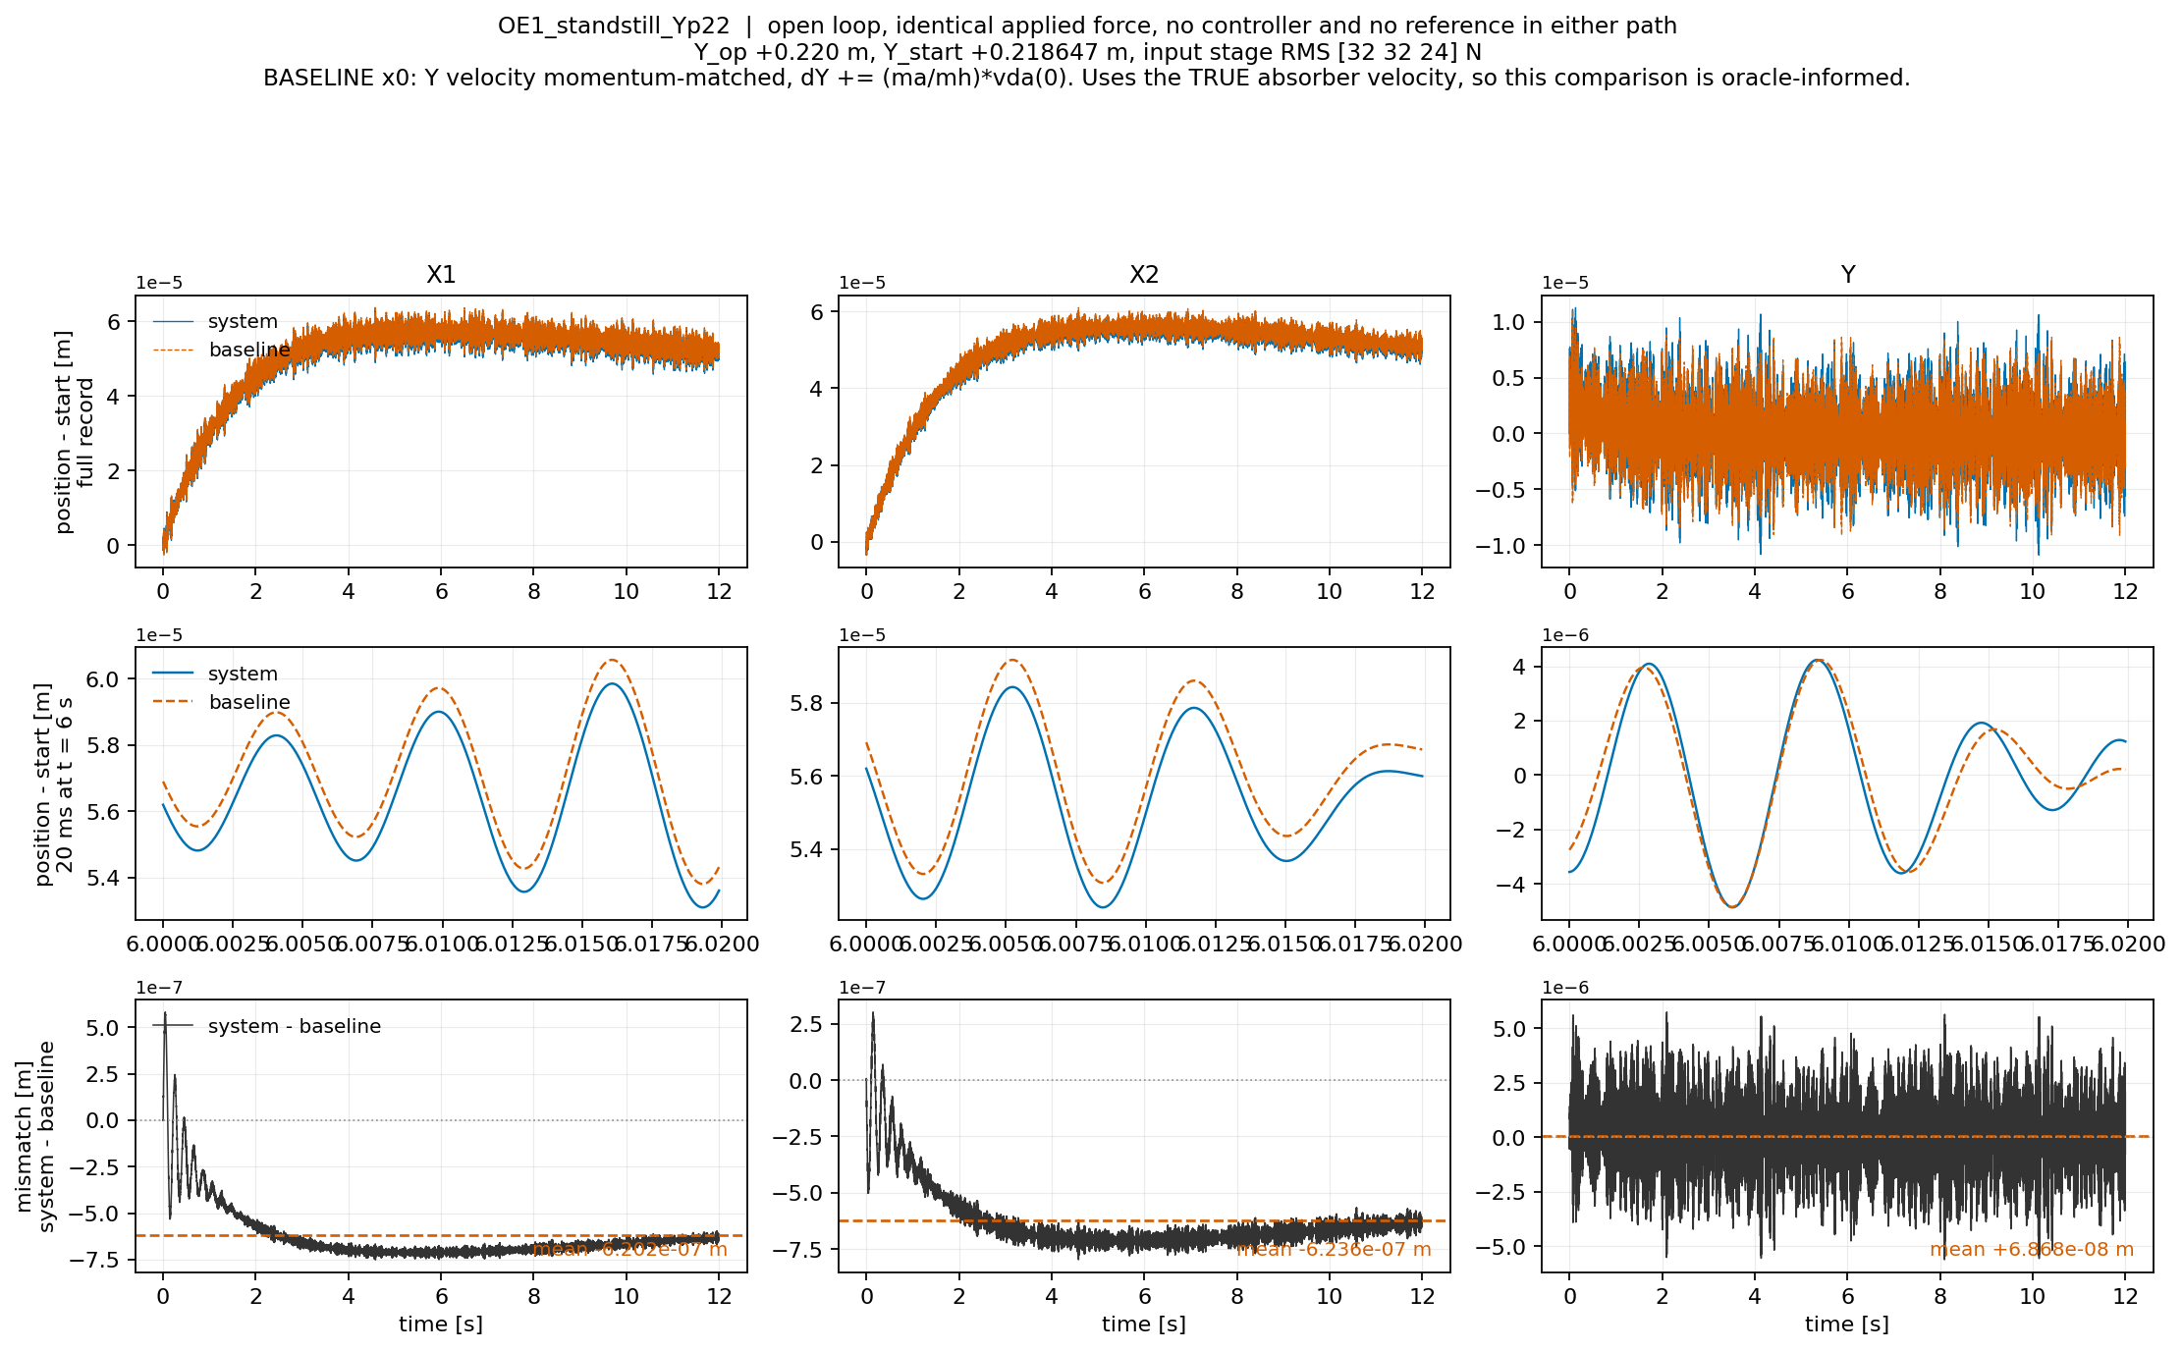

Slide 22
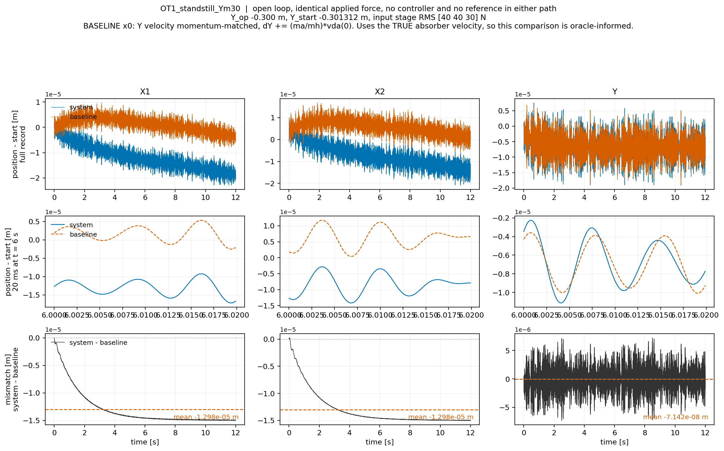

Slide 23
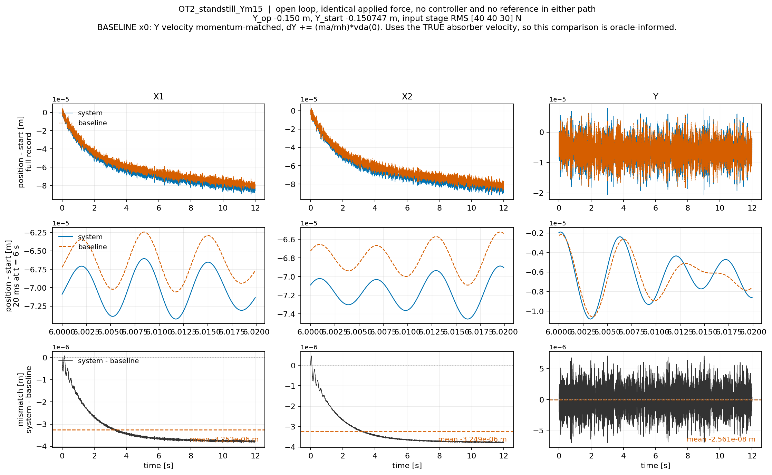

Slide 24
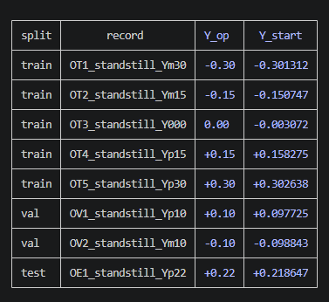
Baseline + ANN
Training
Less data, only standstill no reference

Slide 25
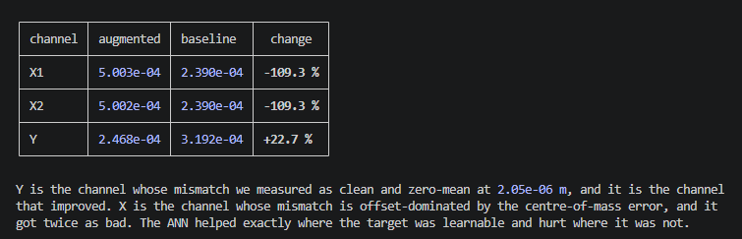

Slide 26
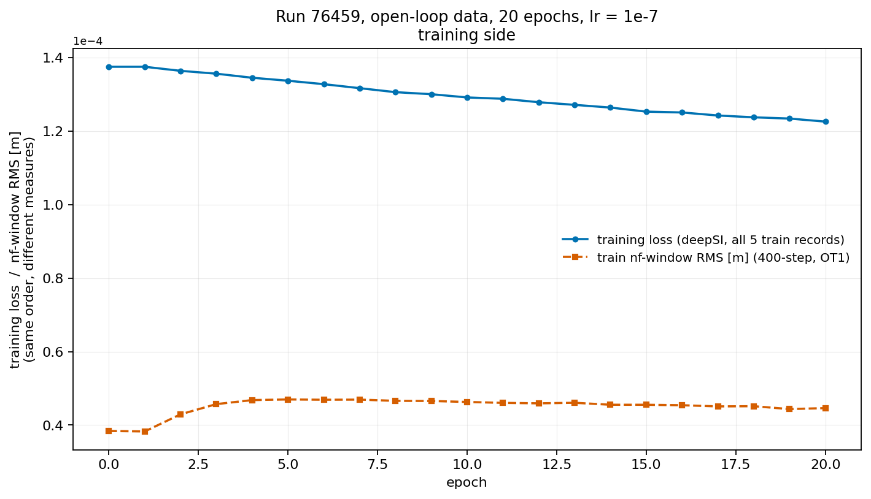

Slide 27
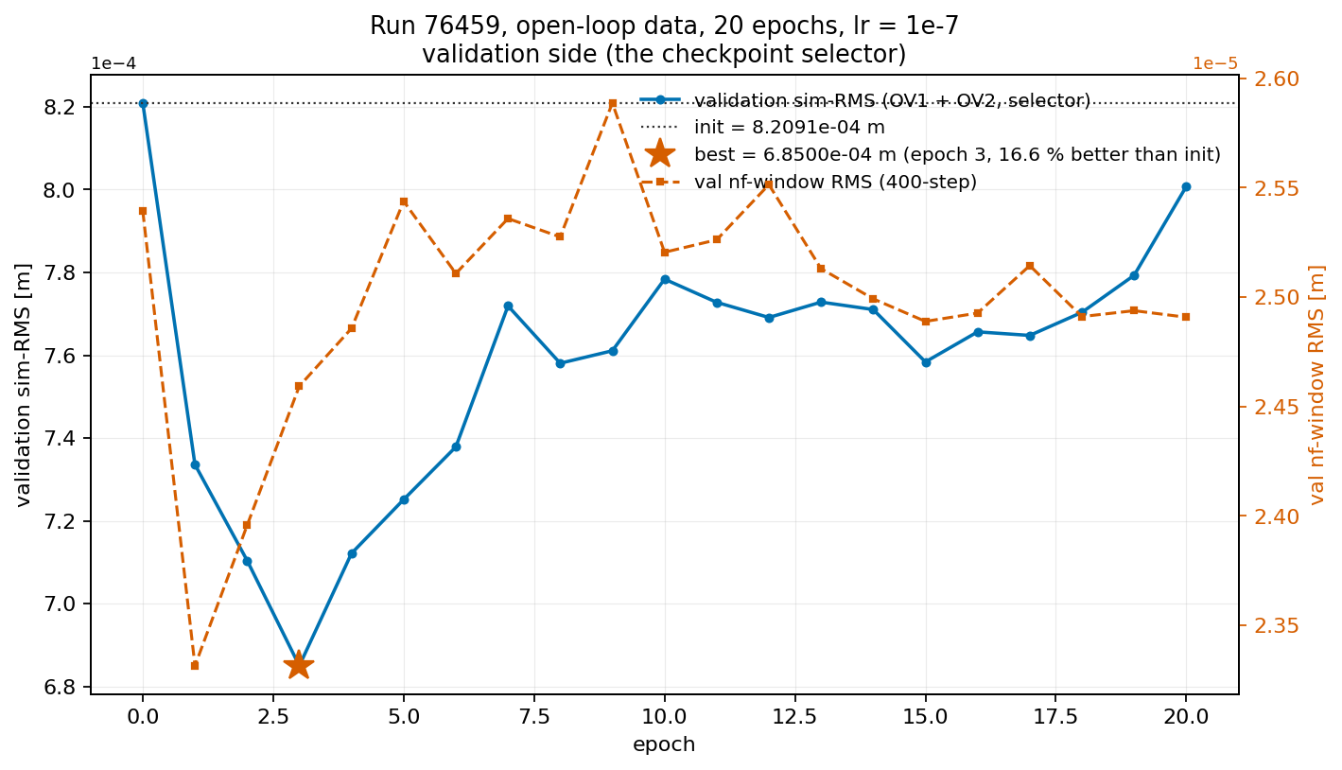

Slide 28
Looks like mismatch training window and validation window

Slide 29
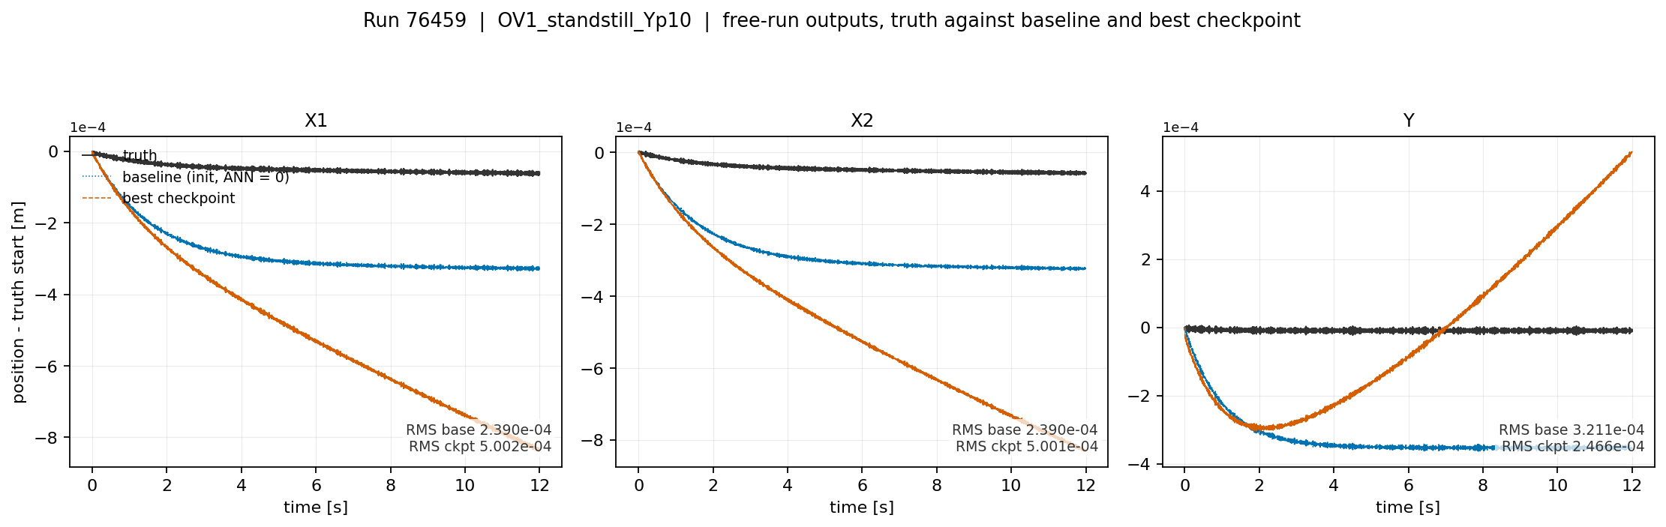

Slide 30
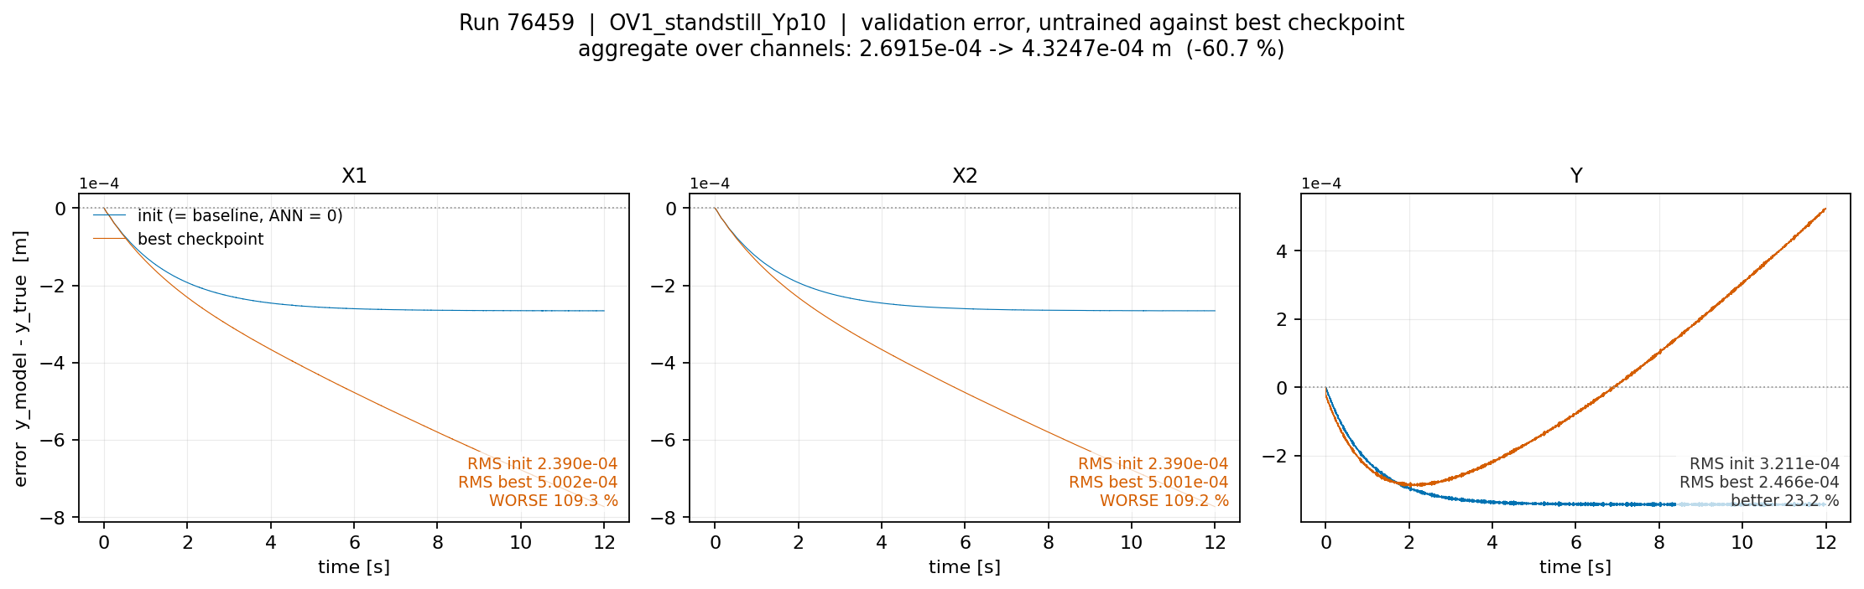

Slide 31
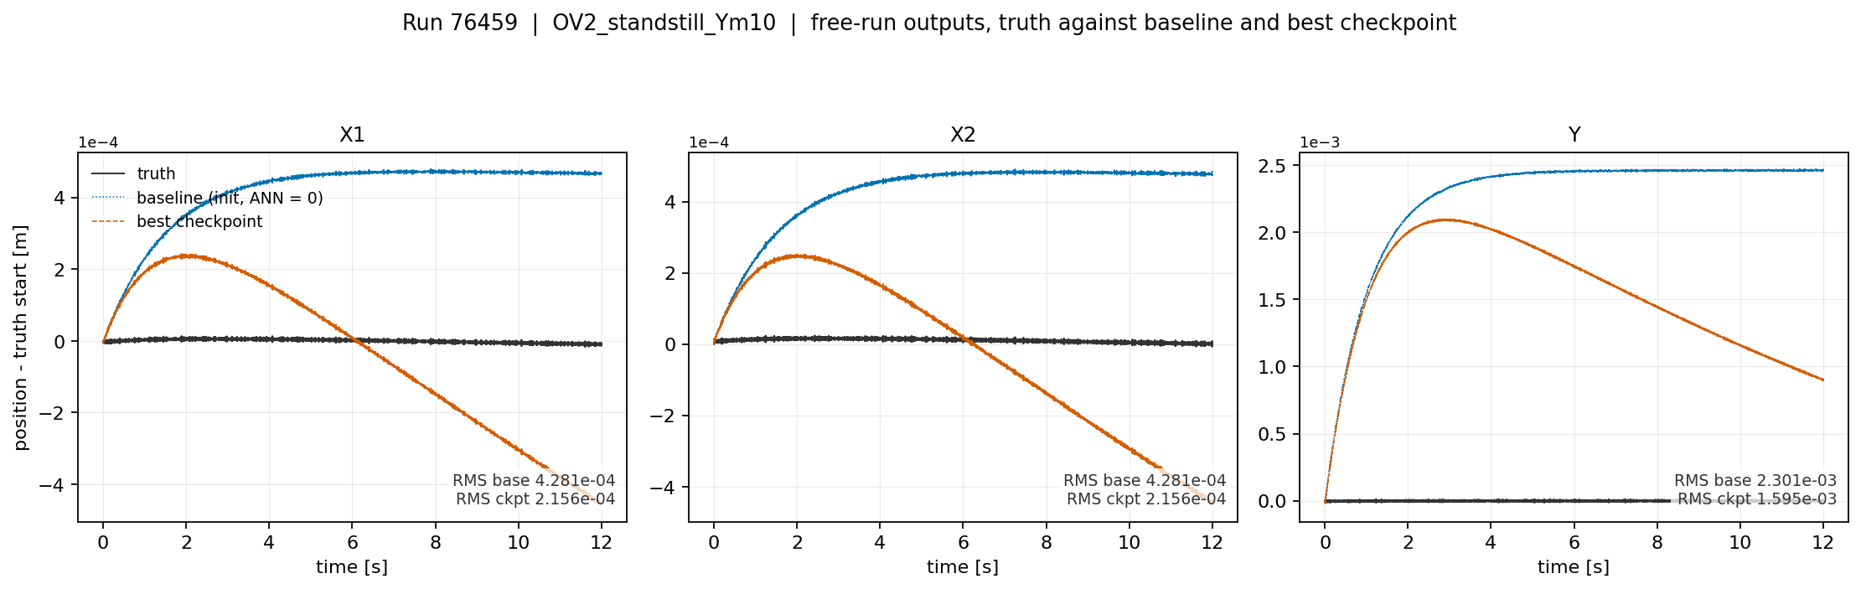

Slide 32
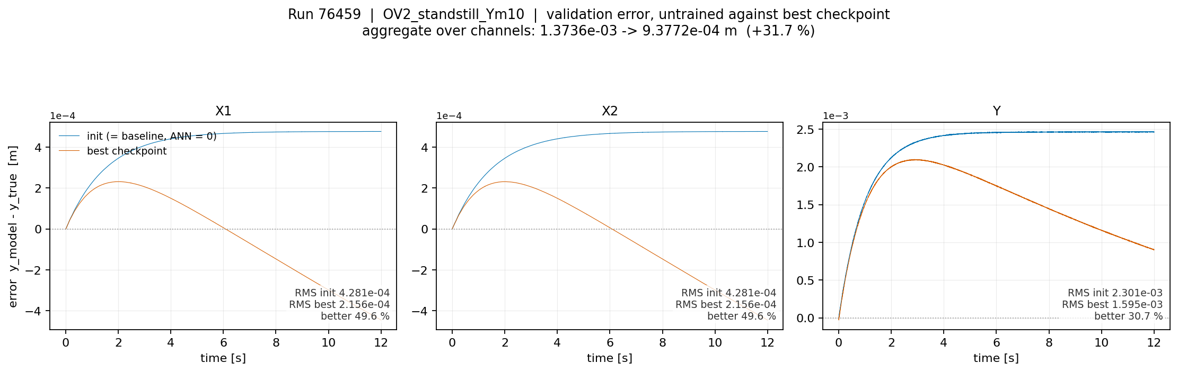

Slide 33
Controller
System Identification Lecture 11: Closed-loop Identification

Slide 34
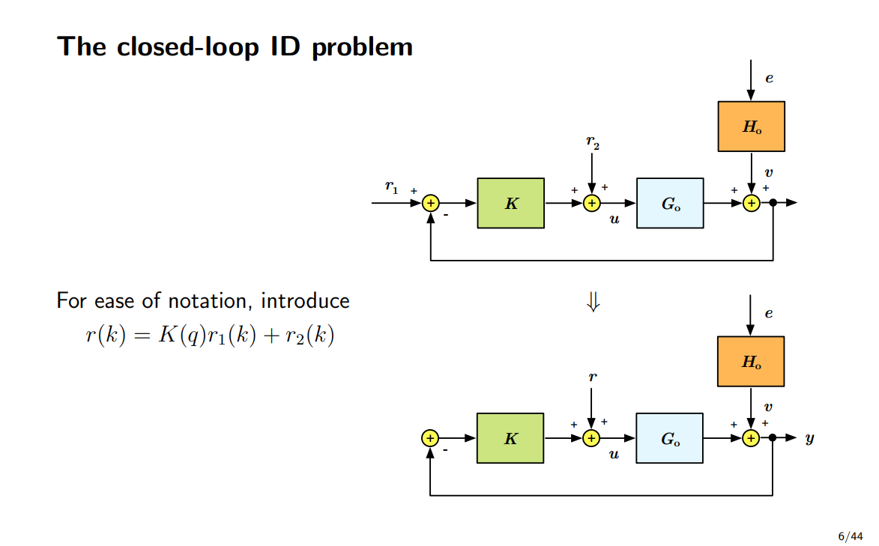

Slide 35
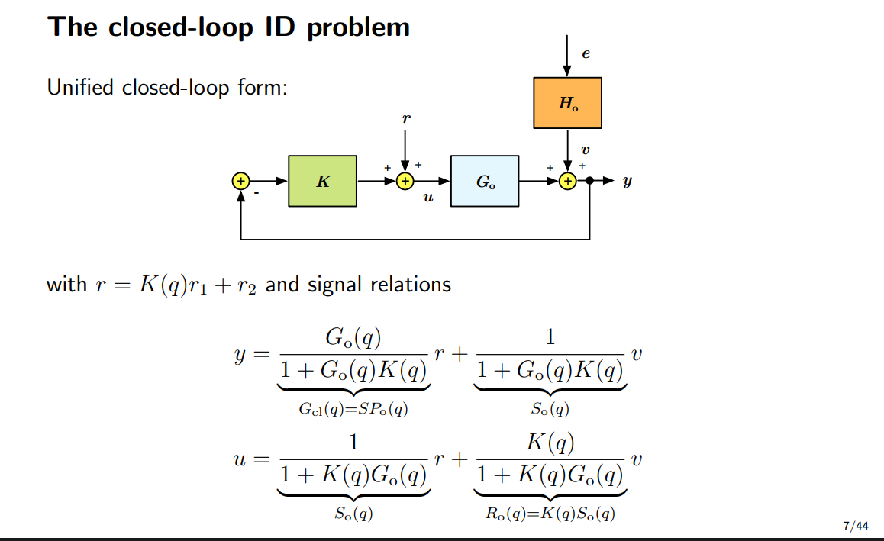

Slide 36
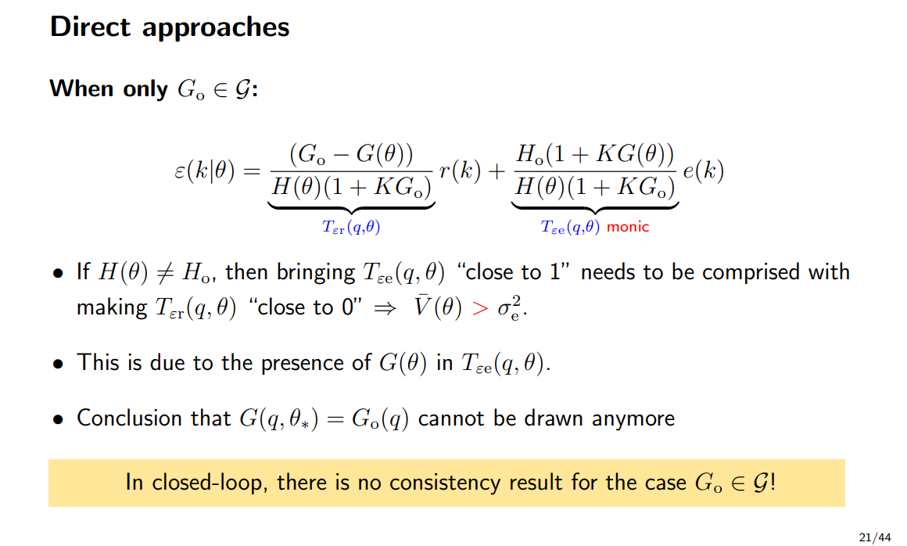
Notes:
No noise V=0

Slide 37
Question
What to do with the controller states during training? For windowed training
Not part of the subnet encoder?
Options:
  Drive the loop from r
  Drive the loop from the recorded input

Slide 38
Write out controller
Step 1:
  Read the three factors out of ruleOfThumb.m. With fbw = 100 Hz and w = 2*pi*fbw
    integrator (s + w/6) / s
    lead-lag (s + w/3) / (s + 3w)
    roll-off 10w / (s + 10w)
Step 2:
  Multiply them into one transfer function
  Cnorm(s) = 10w (s + w/6)(s + w/3) / [ s (s + 3w)(s + 10w) ]
  Numerator degree 2, denominator degree 3. One pole at the origin, that is the integrator.

Slide 39
Step 3:
  Build the plant the controller is normalised against
  M(Y_op) frozen at the operating Y
  Transform state space to stage frame instead of logical coordinates
Step 4:
  Compute the gain, one per channel
Step 5:
  Scale: Three SISO controllers, same shape, different gains.
Step 6:
  Discretise
Step 7:
  Realise as state space
  I will get controller states
Step 8:
  Connect it to the first-principles model
Notes:
Step 4. Compute the gain, one per channelEvaluate at the design frequency s = i*w and take the diagonal entries:kappa_j = 1 / | sys_jj(i w) · Cnorm(i w) | j = 1, 2, 3This forces |kappa_j sys_jj Cnorm| = 1 at 100 Hz, so each channel crosses over at the design bandwidth.

Slide 40
Controller state init
Bas Kessels
4. His only reason SUBNET fails closed-loop is random initialisation into instability, not an information argument. He never engages the sigma_max(So) = 0.021 attenuation objection in section 8. So the "against" argument in the handoff remains unanswered by this reference.
1. The controller-state initialisation fix is his Remark 5.4 (p. 157). Since f_FB and g_FB are known, the FB states are either read from the machine or reconstructed from measured y, known r and the controller. In the industrial case (p. 171) he does exactly that: FB states extracted from measurement data, not encoder-initialised. Our zero-init is not a variant of his method, it is a defect relative to it. The handoff's planned fix is the literature-correct one.

Slide 41
Well posedness closed-loop
- Well-posedness of the loop closure, which needs I + D_G D_C invertible. Your plant has D_d = 0 (gantry_ss.py:138), so there is no algebraic loop and the star product exists unconditionally. This is the same fact closed_loop.py:11-13 relies on.- The controller must not itself carry scheduling into Δ. Here it partly does: kappa_j = 1/|Gop_jj(iw) Cnorm(iw)| depends on Y_op through Gop. If the machine schedules those gains live, Y appears in both the plant and controller blocks and your Δ picks up repeated Y blocks, which complicates both well-posedness certificates and the projection. Worth checking, but the P2 table suggests it barely matters: sigma_max(So) at 150 Hz is 1.7983 at Y = 0.10 against 1.7937 at Y = 0.00, a 0.3 % difference. Treating Cfb as frozen LTI inside the LFR is defensible on those numbers.

Slide 42
Generated offset
Error in
Initialization error, not plant dynamics.
Initial state

Slide 43
Open-loop vs Closed-loop
Generated data with system with MSD
Replay with baseline model without MSD
Notes:
The initial condition was written into the training model, whose states are normalised for training, and zero in those units means the training-set mean velocity rather than rest.

Slide 44
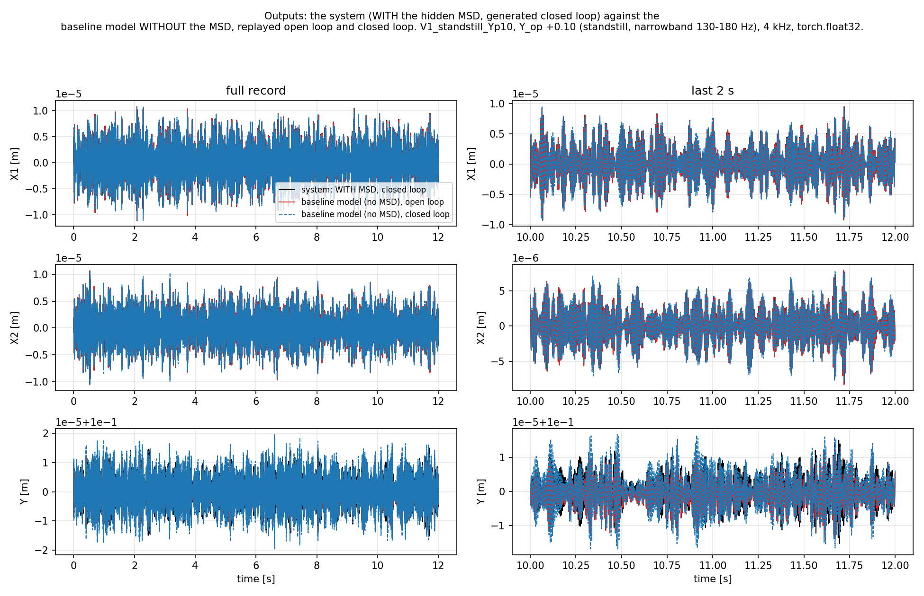
Notes:
The initial condition was written into the training model, whose states are normalised for training, and zero in those units means the training-set mean velocity rather than rest.
The script generated data by running fs.hfn, the training model. That model's state vector is normalised, because normalisation is what training needs. So to set its initial state you have to hand it a normalised vector, and 0 there does not mean 0 m/s.If the script had used the physical simulator instead (deriv6 in msd-offset/plant.py, float64, plain SI units), 0 would have meant 0 m/s and there would have been no bug.

Slide 45
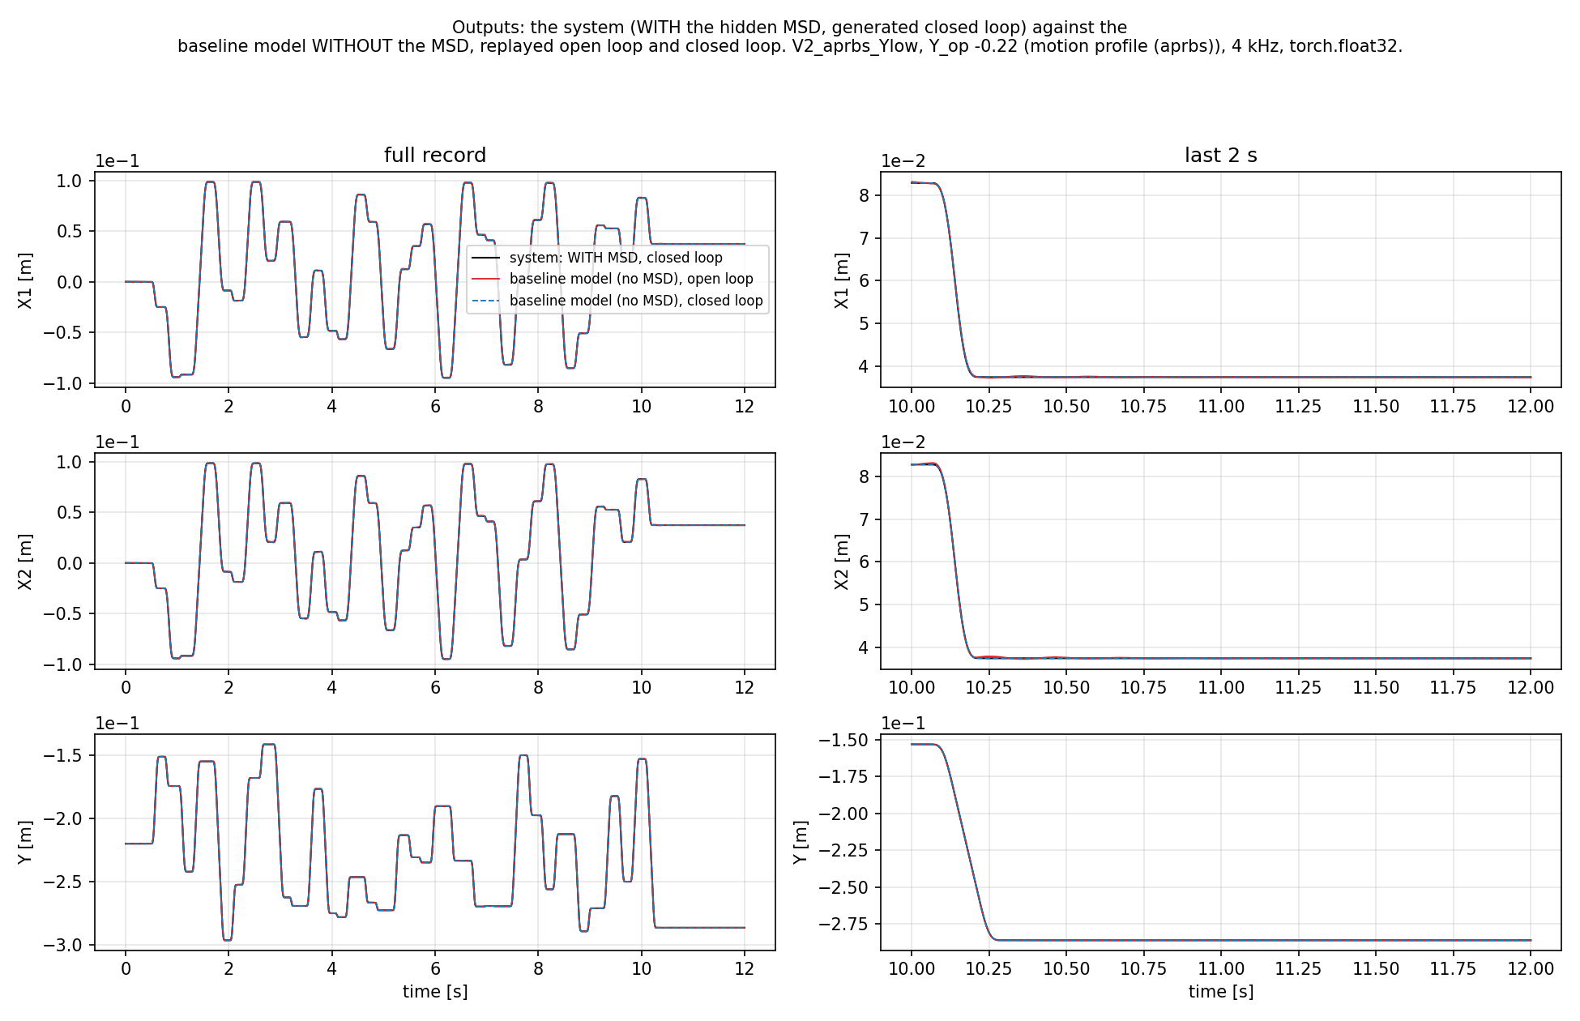
Notes:
The initial condition was written into the training model, whose states are normalised for training, and zero in those units means the training-set mean velocity rather than rest.

Slide 46
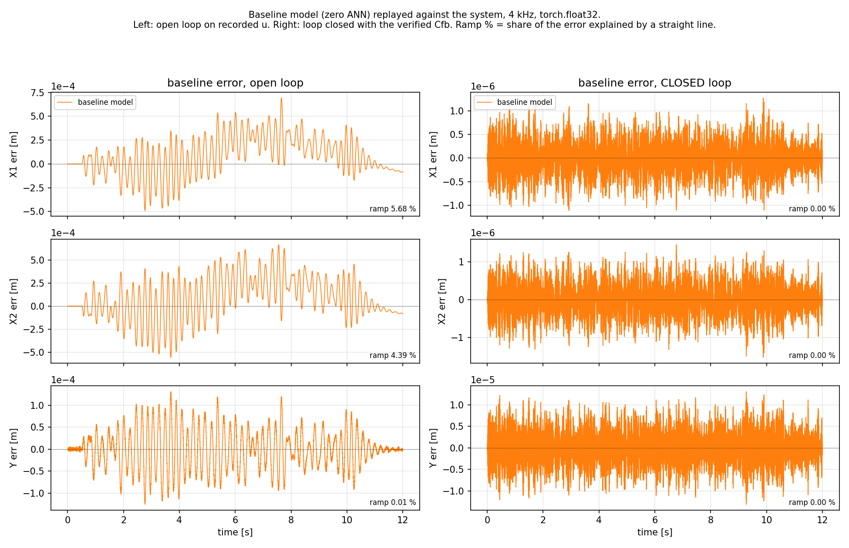

Slide 47
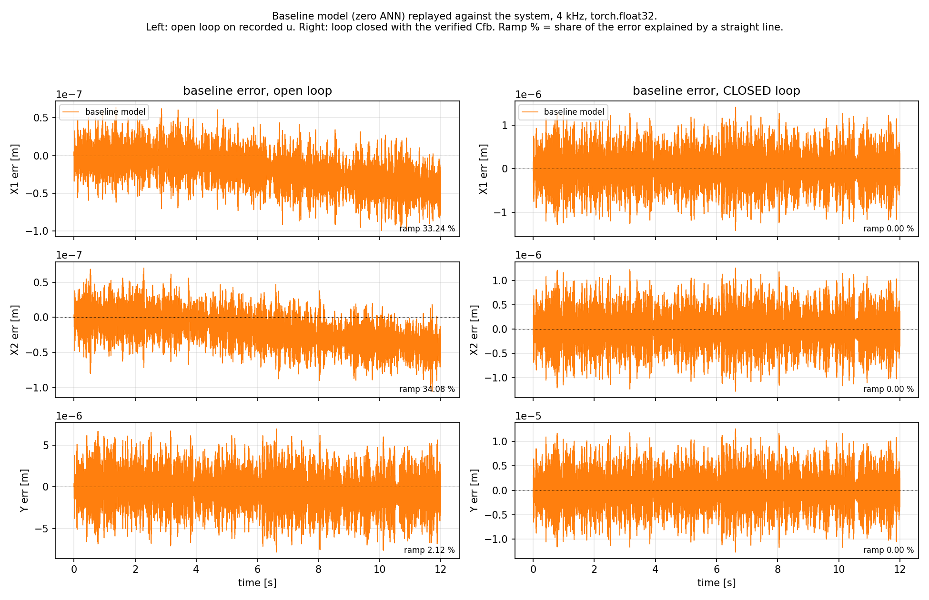

Slide 48
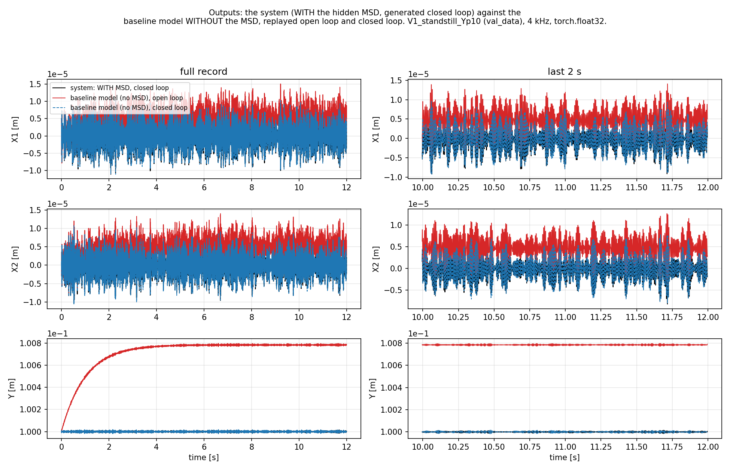

Slide 49
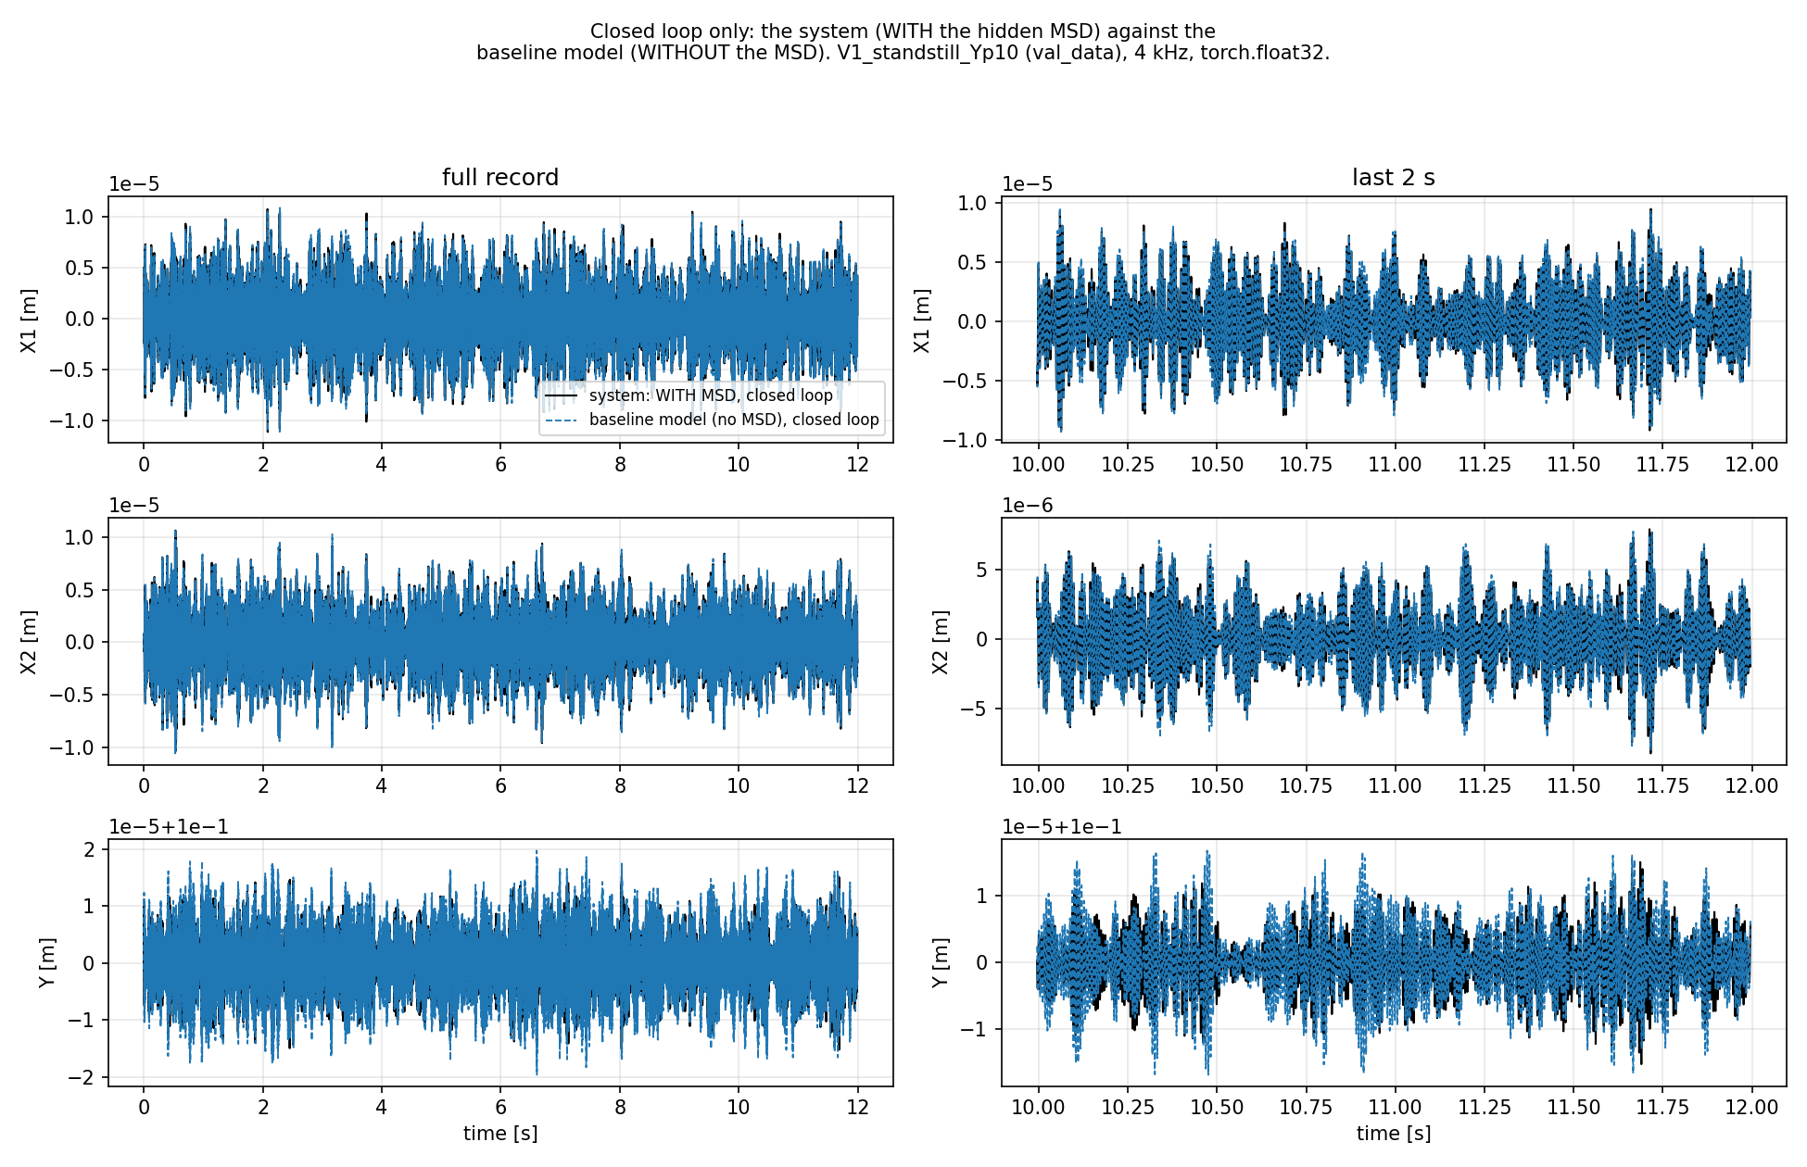

Slide 50
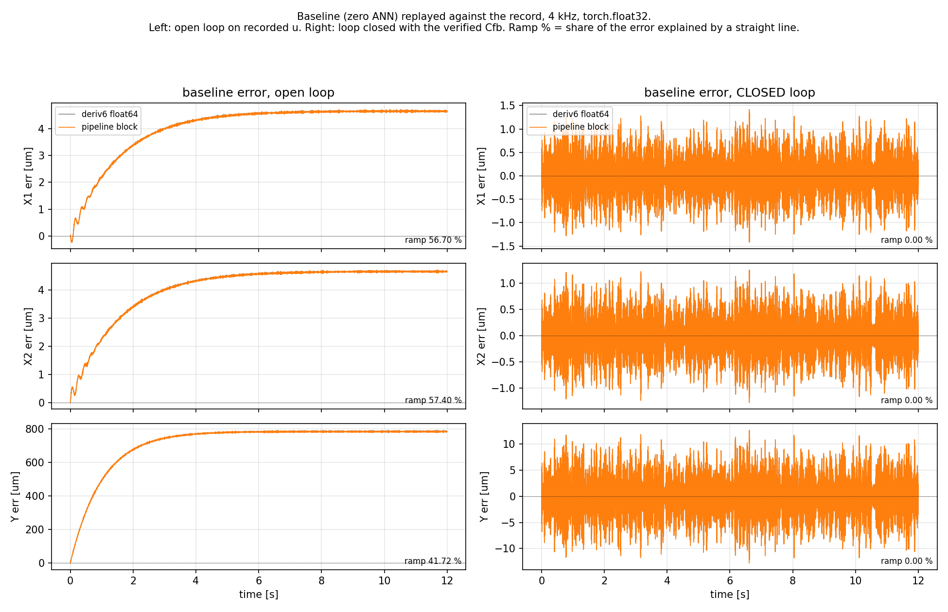

Slide 51
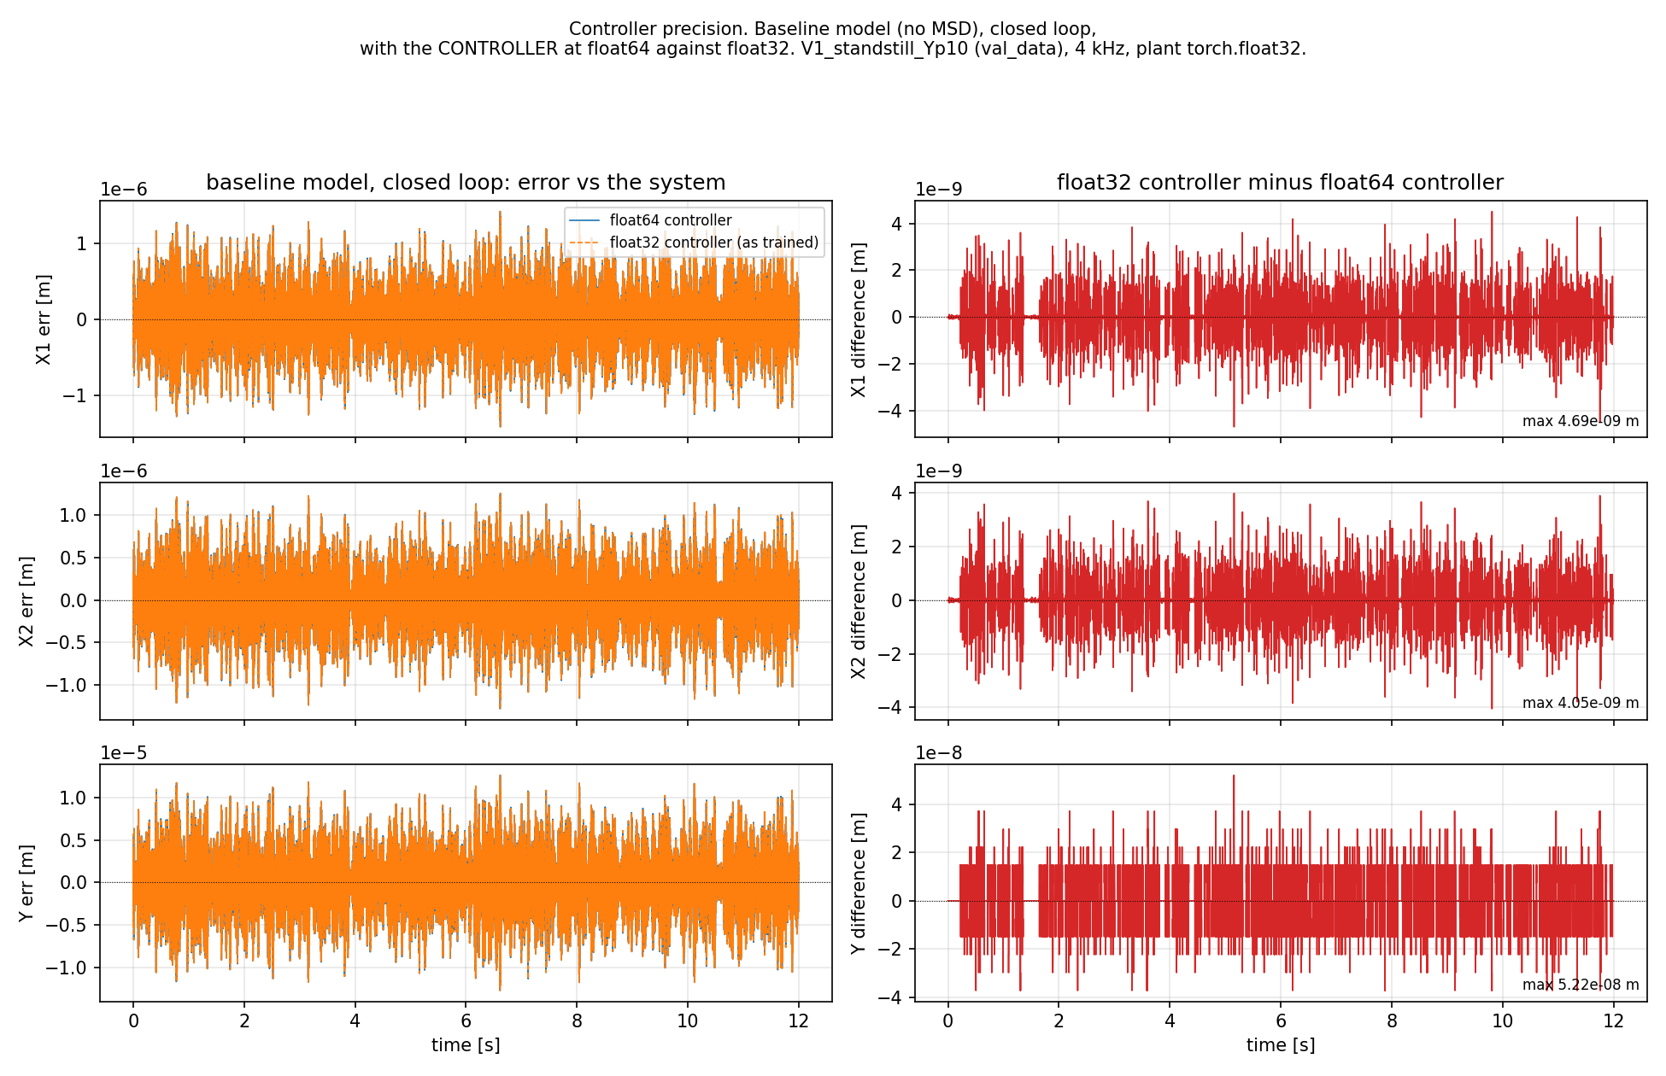

Slide 52
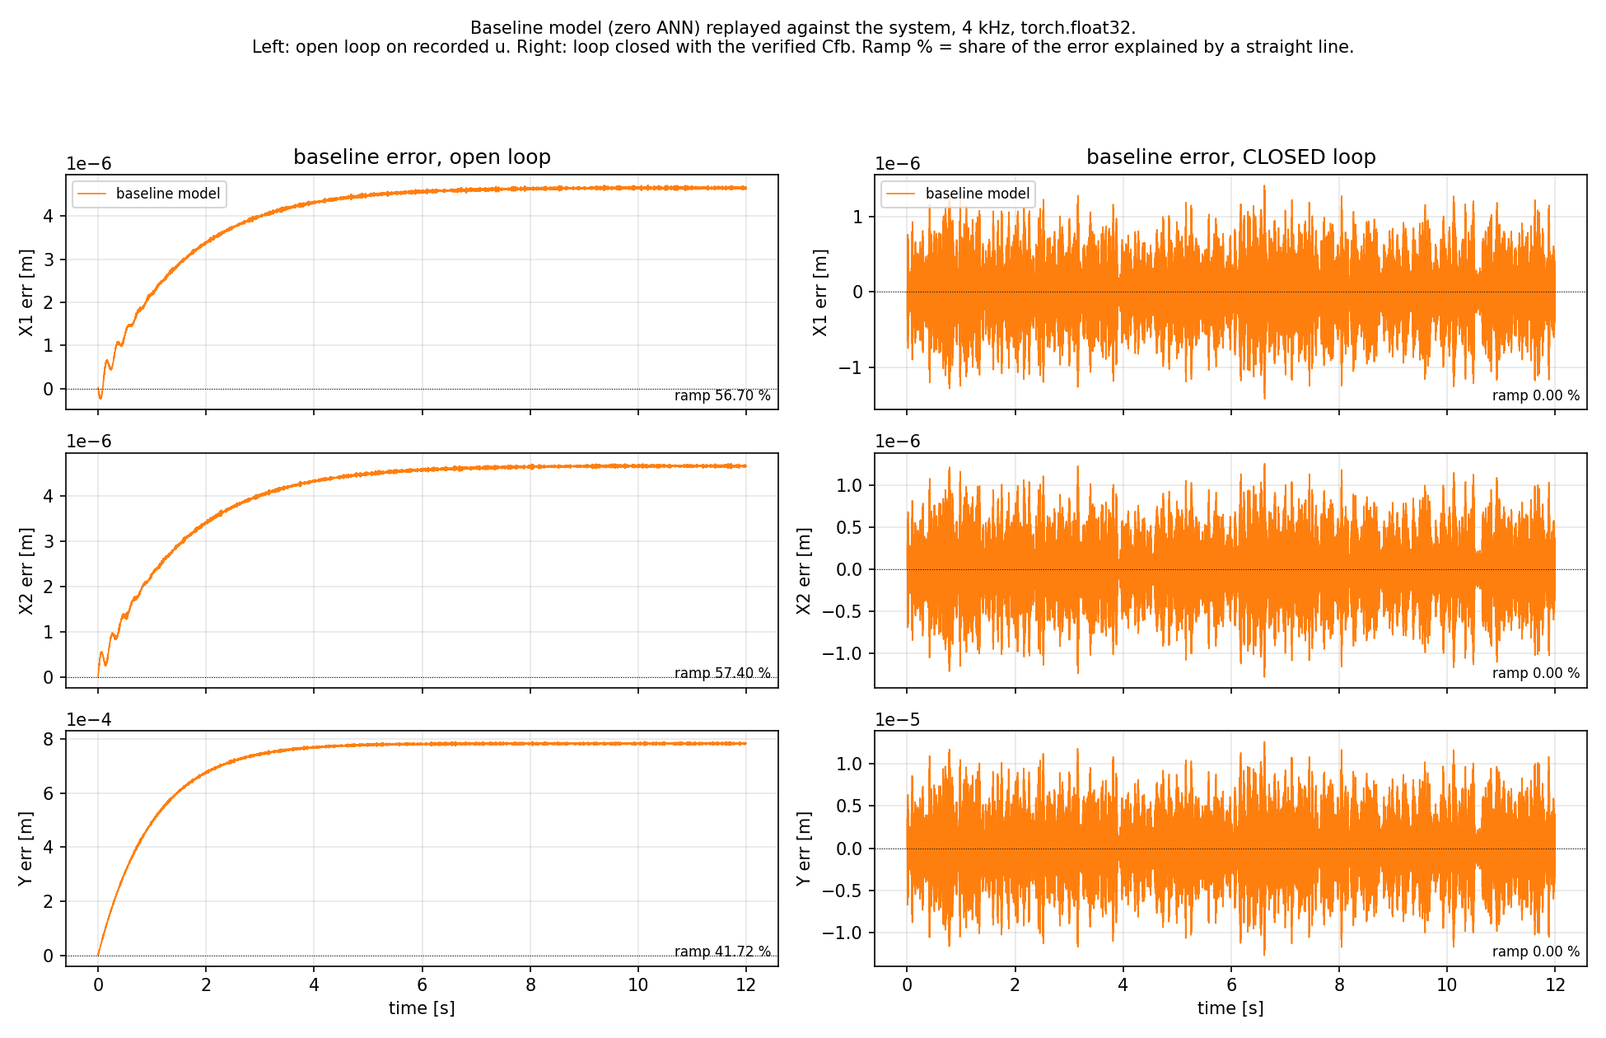

Slide 53
Variant B controller?
Kessels recommened variant A??

Slide 54
2. Y_OP = 0.10 is hardcoded at train_variants.py:52, one controller for all 14 training records. But the records were generated with a per-record operating point (D-039)
So the accurate statement is: the controller removes the offset and amplifies the resonance. Not "the controller does not fix the issue".
currently we were under the impression that we get an offset due to the open-loop closed-loop mismatch and that were dynamics of circa 6 seconds. because the ANN is unable to learn / improve over the linear encoder init with ANN-off we thought this was due to slow dynamcis which the window cant see, but currently that no longer seems to be the case.

Slide 55
Closed-loop controller
Implementation

Slide 56
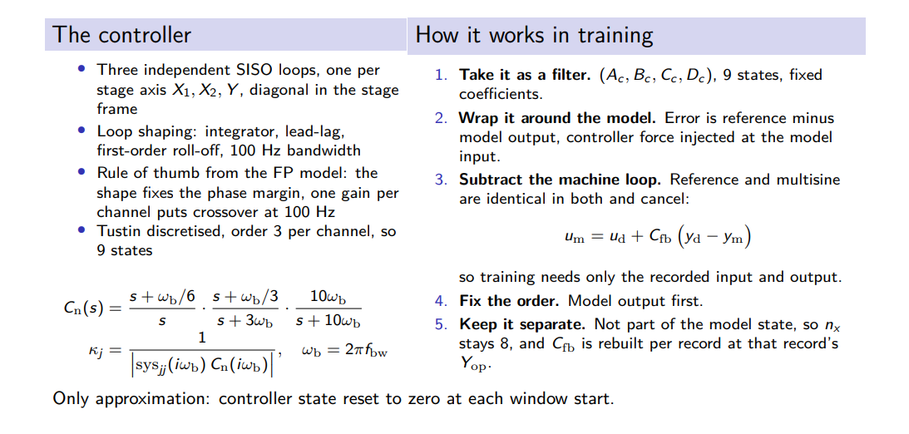
Closing the loop in training
Notes:
It is the discrete controller $\Cfb(z)$ written as a recursion instead of a transfer function.$$x_{c,k+1} = A_c x_{c,k} + B_c e_{c,k}, \qquad \ufb{}{,k} = C_c x{c,k} + D_c e_{c,k}$$

Slide 57
Controller function in Matlab
function C = ruleOfThumb(fbw, sys, ts)
s = tf('s');
int_factor = 1/6;
int = (s+2*pi*fbw*int_factor)/s;
leadlag_factor = [1/3, 3];
leadlag = (s+2*pi*fbw*leadlag_factor(1))/(s+2*pi*fbw*leadlag_factor(2));
lowpass_factor = 10;
lowpass = 2*pi*lowpass_factor*fbw/(s+2*pi*lowpass_factor*fbw);
Cnorm = int*leadlag*lowpass;
K = 1/abs(freqresp(sys*Cnorm, 2*pi*fbw));
C = K*Cnorm;
C = c2d(C, ts, 'tustin');
end

Slide 58
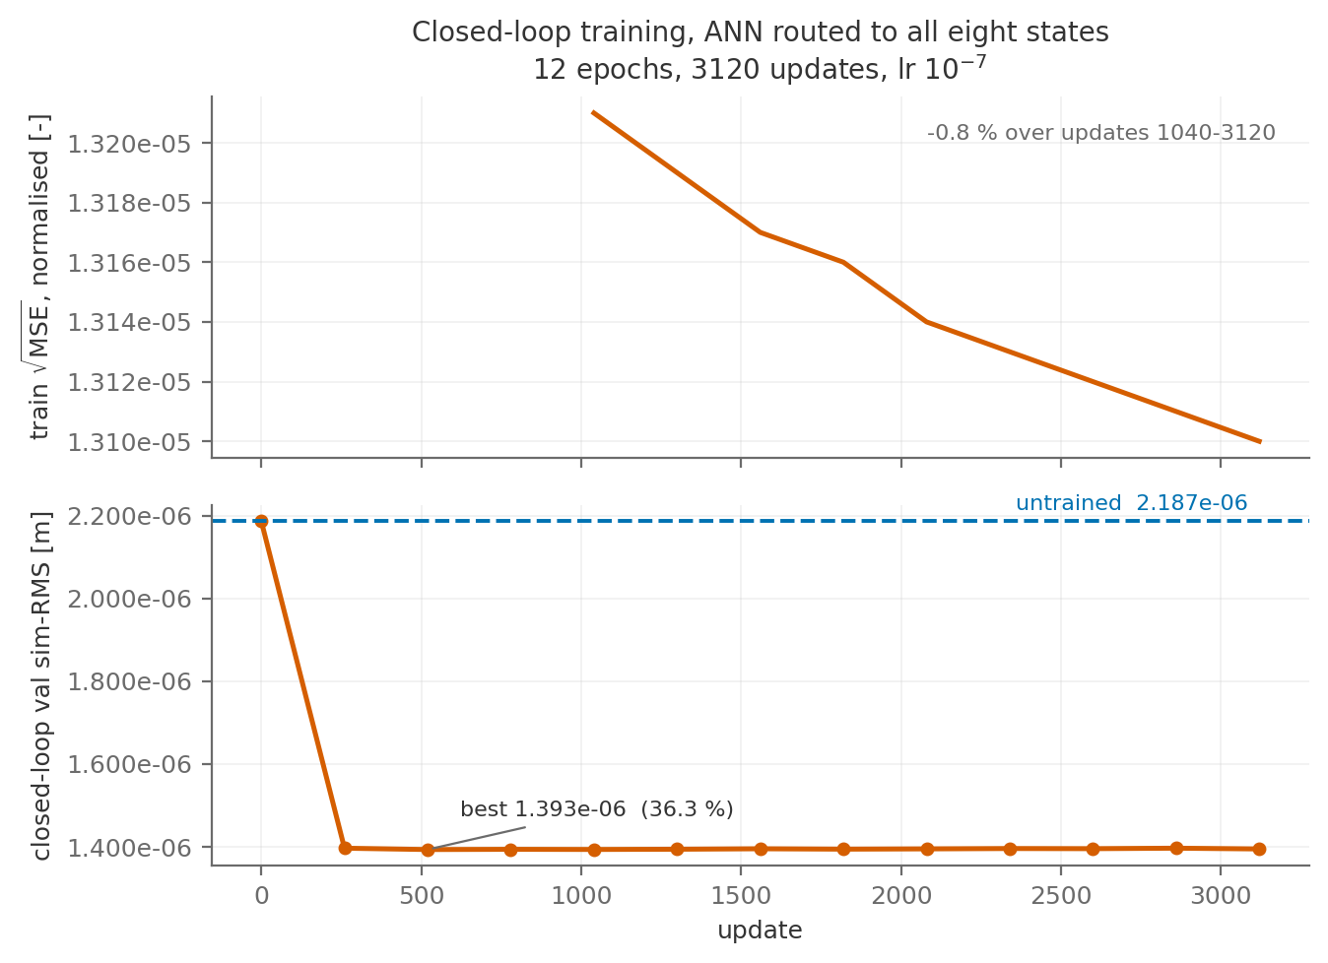

Slide 59
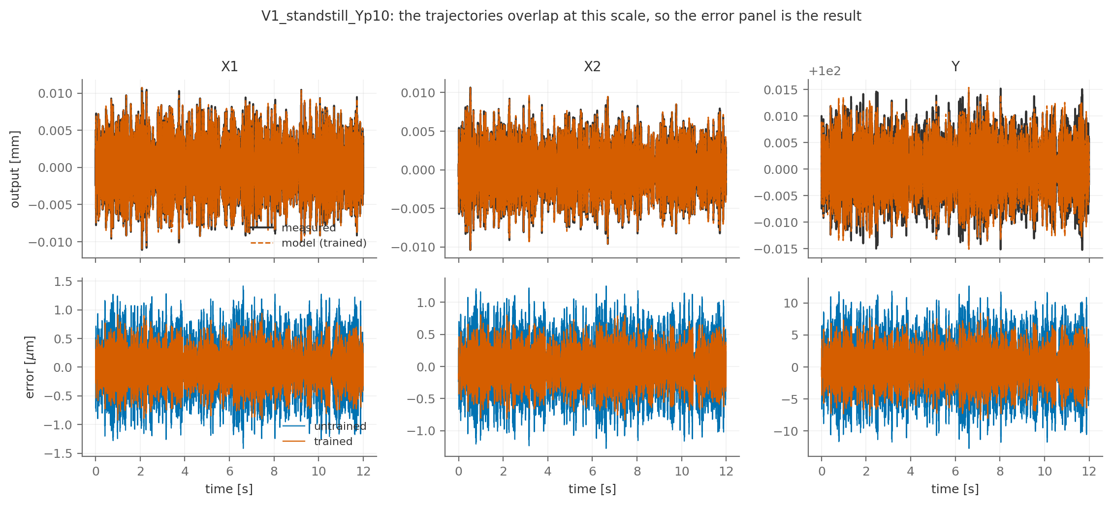

Slide 60
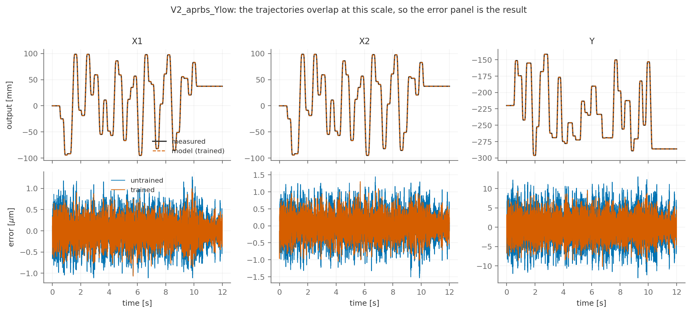

Slide 61
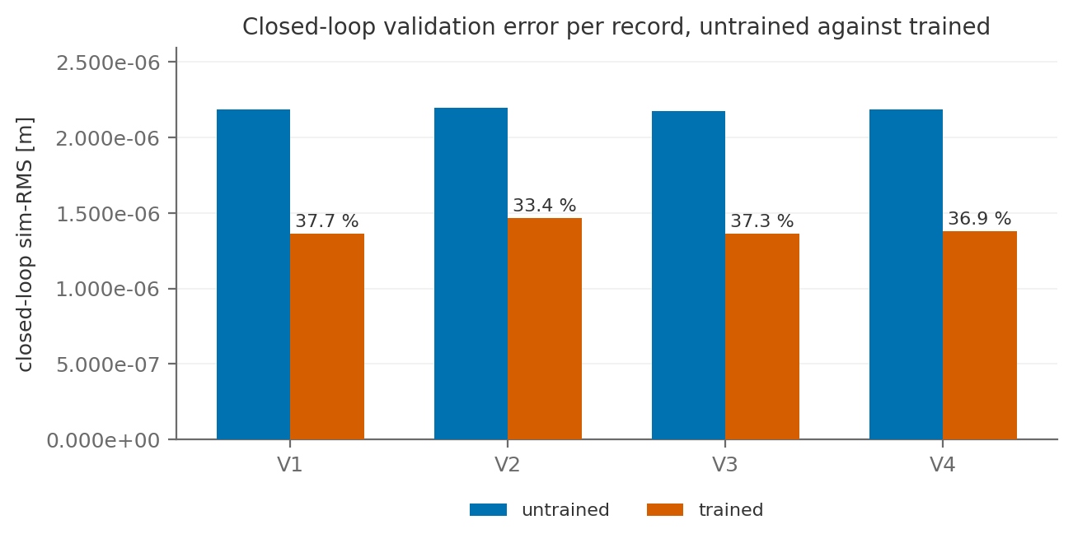

Slide 62


Slide 63
horizon, lr

Slide 64
To do
First make training match closer to perfect system
  Better than 36% improvement
Vary hyperparameters
  Learning rate, training window
    Also look into downsampling further

Slide 65
Answer to why we can do this substraction
1. The condition that is real is that both loops apply the same operator. They do, because Cfb is frozen at the record's Y_op, which is exogenous. A controller scheduled on the model's own state would break the subtraction while still being linear. Worth conceding before they find it.2. delta is not zero. At the 4 kHz training rate, the stored u_total differs from Cfb(r - y_d) + f_ms by about 10 % of u_fb on V1 and 1.6 to 2.7 % on T10. That is the 20 kHz to 4 kHz re-discretisation, present at ANN gain 0 too, so it is a sample-rate issue and not a nonlinearity issue. It is a real modelling gap, separate from the algebra.3. A new finding, unresolved. At nf = 400 in float32 with a random ANN, two mathematically identical rollouts differ by about 8x the model error. If that also holds for a trained checkpoint, the closed-loop training loss is partly numerical noise and the path wants float64 or a shorter window. Untested with a real checkpoint.
the scheduling of the controller is exogenous, not model-dependent.
Because we only use Y_op. and indepdent of controller we can do this.
2. Whether both loops apply the same operator. This is the sharp version of their worry, and it is a genuine condition. The cancellation needs $\Cfb$ to be the same map on both sides. Here it is, because $\Cfb$ is built at a frozen $Y_{op}$ read from the record, so the machine and the model use identical coefficients. But if $\Cfb$ were scheduled on a signal that differs between machine and model, for example on the model's own $Y$ position rather than the record's, the two operators would no longer be the same and the subtraction would fail, even though each is individually linear. Worth stating that you checked this: the scheduling of the controller is exogenous, not model-dependent.

Slide 66
Windowed training
Controller init states→ zero
- Zero is not an arbitrary pick. It is the only value for which the correction $\Cfb(y_d - y_m)$ vanishes when the model is exact. Any other initialisation injects a force into a perfect model.- The cost is integral memory, not accuracy of the state. $\Cnorm$ has a pole at $s=0$, so $\Cfb$ has a pole at $z=1$ and never forgets DC. The validation free run accumulates that over the whole record while each training window restarts it. That asymmetry is the 8.5 to 13.4 % measurement, and it is the thing to name before a supervisor names it.

Slide 67
Orthogonality
LPV
Precompute only goes stale in the variables the optimizer moves. It doesn't move Y. So the good news is real, it's just narrower than "not Y-dependent": you get correct, fully scheduled parameter directions at zero per-epoch cost.The flip side of the same fact, and the reason stratification matters: the subspace only knows the Y values that are in the point set. Outside them it is blind. Y-dependence baked in for free, and Y coverage as a hard limit, are the same statement.

Slide 68
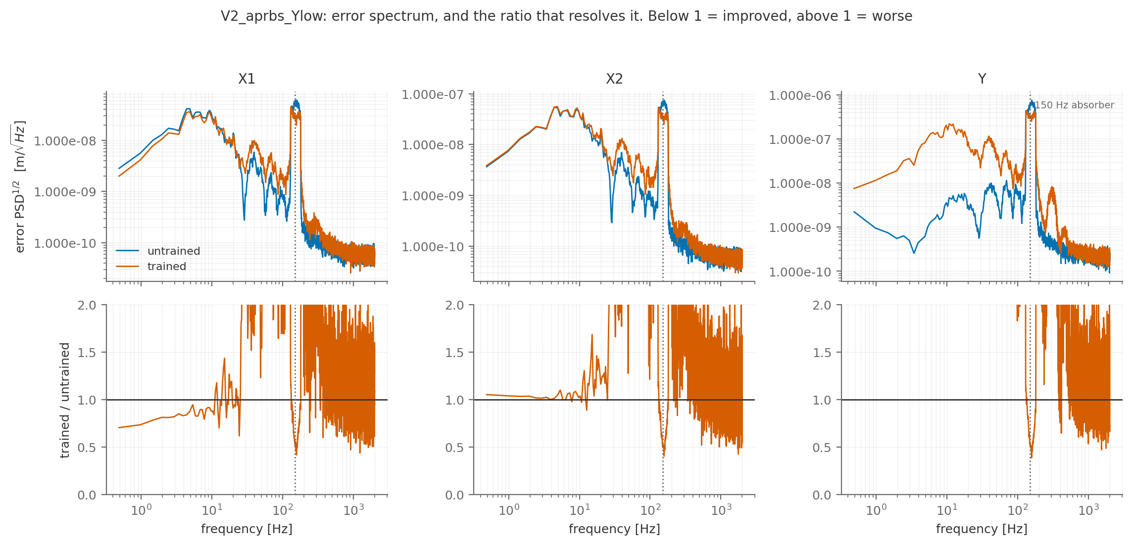

Slide 69
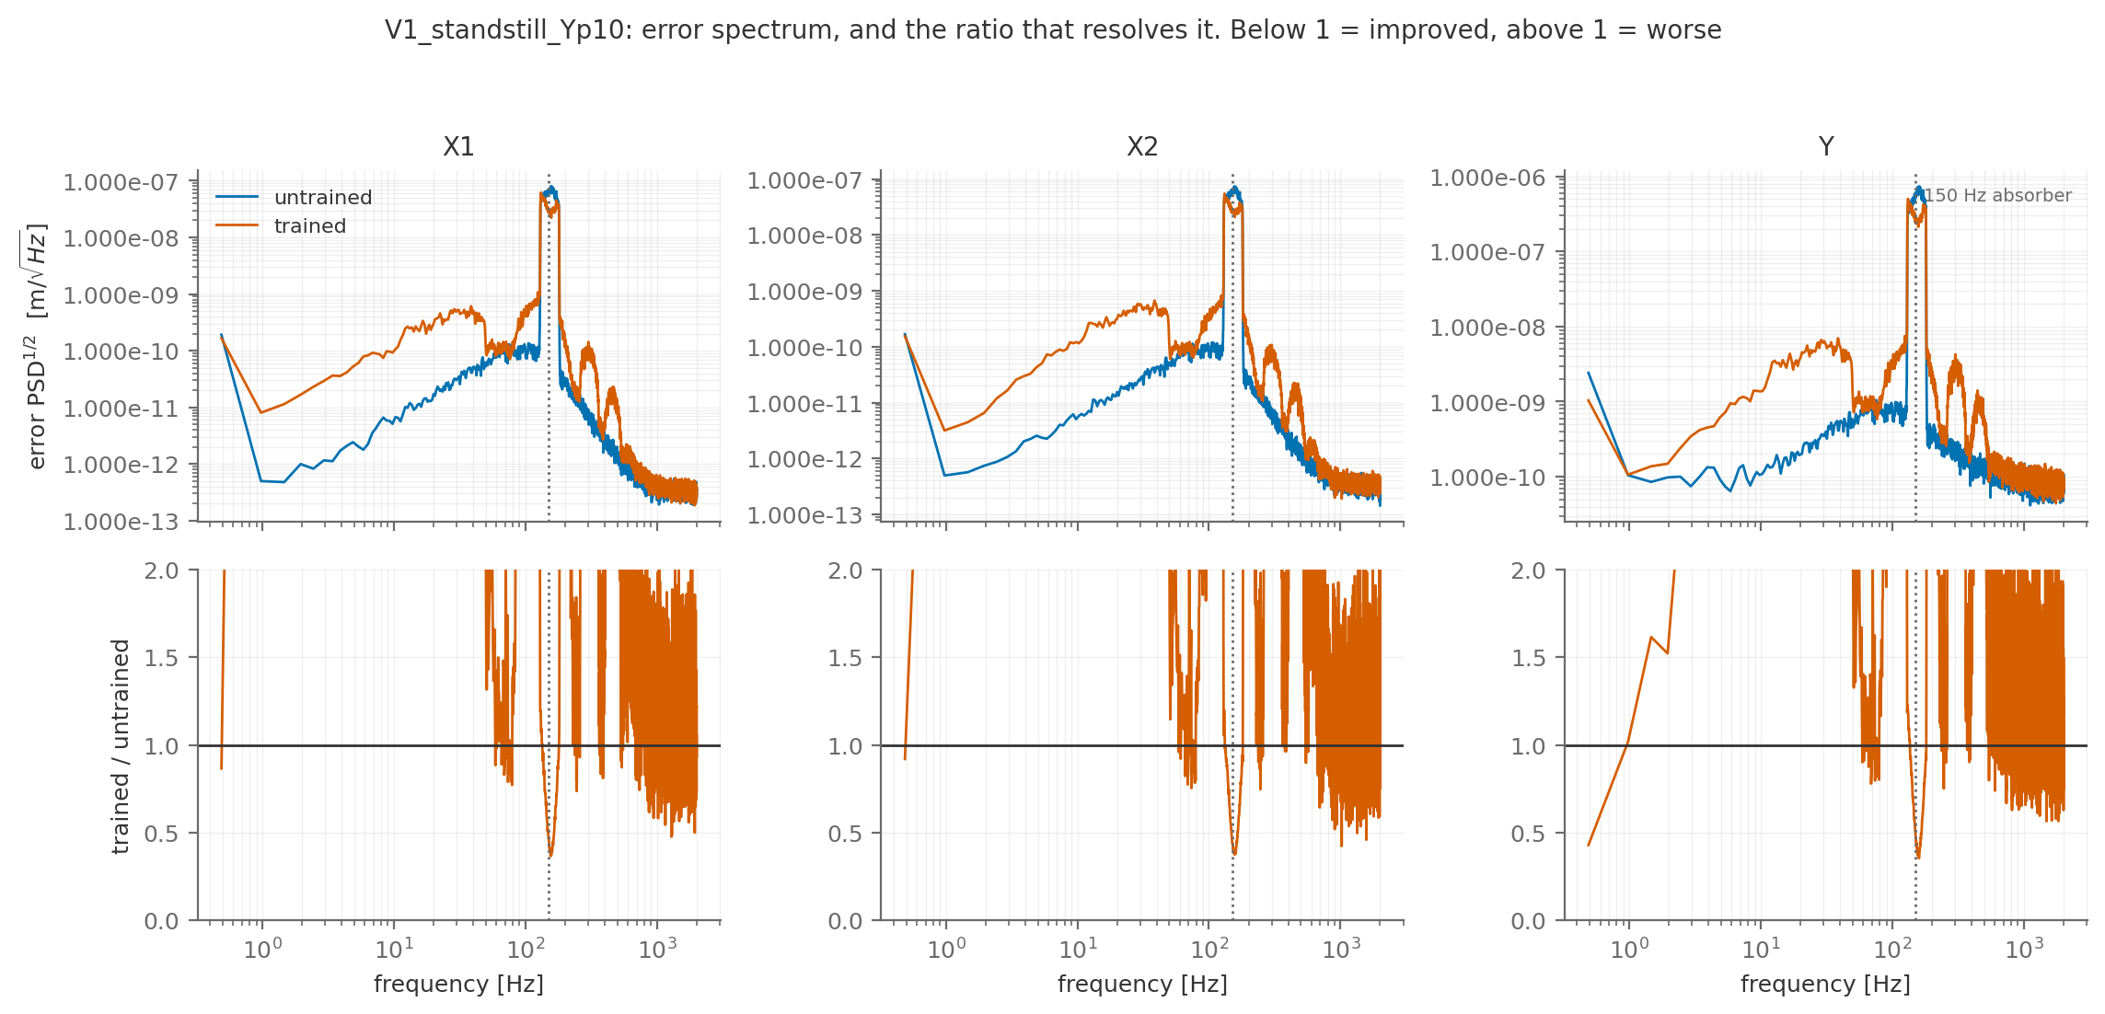

Slide 71
Eps issue ANN training??

Slide 72
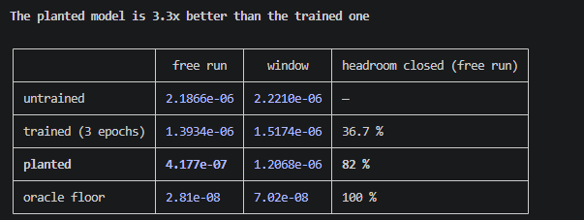

Slide 73
Problematic encoder init for augmented states
But it does not close the gap I attributed to it. Even with the true latent state at every window start, the planted model scores 7.16e-07 on windows against 4.18e-07 on the free run and 7.02e-08 on the floor. So the latent initialisation accounts for about 41 % of the window penalty, not all of it; the remaining 1.7x between window and free run is the horizon itself, and a further 10x sits between that and the floor. My earlier framing — "the entire window penalty is the latent init" — was too strong, and this is the number that corrects it.
which it cannot do, because those rows are the W^a block that receives no gradient and, as measured earlier today, never moves.
Jan does not set W^a to zero. He does not have a W^a at all. linear_encoder_init (pre_encoder.py:193, unmarked, his) produces only the nx physical states from the reconstructability map. The augmented rows are entirely our extension:

Slide 74
Change for random kaimin init to W^a = 0

Slide 75
Change window length for validation sim-rms??

Slide 76
Potential fixes for training the ANN
1. eps = 1e-16 : every parameter trains instead of 23 % of them.
2. per-row output scaling on the ANN : the difference between fitting the absorber rows to 1e-04 and not fitting them at all.
3. W^a = 0 : doubles the objective's discrimination.

Slide 77
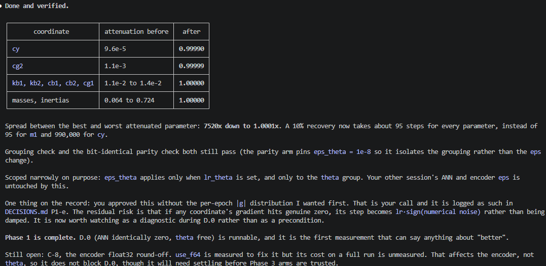
Orthogonality two/seperate learning rates?

Slide 78
Encoder touchup??
The cleaner fix is the trick this project already uses for the physical parameters. log_params works precisely because it is a relative parameterization: theta = theta_init * exp(log_params), so the trainable quantity is O(0) and its updates are always representable regardless of how large theta is. The encoder linear map has exactly the same disease and can take exactly the same cure: store it as W = W_init * (1 + delta) with delta trainable and O(0). Updates become O(lr) against O(1), representable at any dtype and any learning rate, and the analytic init is preserved exactly at delta = 0.The cost is that it touches the encoder construction (D-055), which may collide with your other session.

Slide 79
How to state numbers in thesis
Everything in this experiment happens inside a factor of 78, and 1e-06 sits near the wrong end of it. That is also why I would report the thesis numbers as fraction-of-headroom-closed and as error relative to the absorber-driven content, rather than in metres, where a reader will reasonably think a micron sounds fine.

Slide 80
Controller limits downsampling to 1khz ☹
The controller is the blocker at 1 kHz, and no choice of discretisation fixes it. The design's roll-off pole sits at 10*w_b = 1000 Hz. At fs = 1000 Hz the Nyquist frequency is 500 Hz, so that pole is above Nyquist. Tustin does not drop it, it warps it: with T = 1e-3, a continuous pole at 6283 rad/s maps to 2/T * arctan(w T/2) = 2000 * arctan(3.14) ≈ 2526 rad/s, i.e. about 402 Hz. The controller you would be training inside has its roll-off starting at 402 Hz instead of 1000 Hz. ZOH or matched-pole discretisation does not rescue it either, because a pole above Nyquist has no representation at that rate at all. This is on top of diag(Dc) being 1.23x larger and non-monotone in rate, and on top of the +15.3 % shift in sigma_max(So) that 4 kHz already costs against the 20 kHz loop that generated the data.By that argument the controller rate is bounded below by its own structure at roughly 4 kHz: Nyquist 2000 Hz puts the roll-off pole at half Nyquist, which is where it is representable with margin. At 2 kHz the pole sits exactly on Nyquist, which is still no good.

Slide 81
Potential issue on real data
What it does not do: bias the optimum. In the residual form u = u_data + Cfb(y_data - y_model), if the model is exact then y_model = y_data, the correction term vanishes, u = u_data, and the record is reproduced. That fixed point holds for any stabilising Cfb. So the true model is a global minimiser at zero loss no matter which discretisation of the controller we use. A different Cfb cannot make the wrong model win outright.
Worth doing: score the final model in a 20 kHz loop even though training runs at 4 kHz. The metric bias then disappears from the reported number without touching the training path at all. The cost is a validation free run at 5x the steps, 240k per record instead of 48k, so a few minutes. That would let the thesis report closed-loop performance in the machine's actual loop and keep the 4 kHz choice as a training-efficiency decision rather than a reporting one.

Slide 82
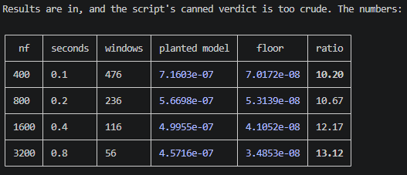
Windowed RMS

Slide 83
Multiple shooting instead of increasing window length??
▎ At a multiple-shooting segment boundary, does the controller state xc continue from the previous segment, or reset to zero as it does at a window start?

Slide 84
Fixed startup transient?
Which points at a cheaper fix than either route I proposed: burn-in. If the problem is a fixed startup transient, the direct remedy is to stop scoring it rather than to dilute it. Simulate the full 400-sample window as now, but exclude the first K samples from the loss. Same gradient depth, same batch structure, same data, no segment-boundary decision, no rate change. In prediction-error identification this is standard practice, not a trick.

Slide 86
Need to look into permanent eps fix?
W^a kaiming init, instead 0 init?
Look into multiple shooting to increase window length instead of increasing nf??

Slide 87
Joint data issue
Dynamics not excited
Yes, in a bounded and fixable way. cfg.f_low = 1 for the joint track, so the multisine never excites below 1 Hz, which is a decade above these poles. Two things would be needed to identify them: excitation down to about 0.1 Hz, and longer records, because a 12 s record has 0.083 Hz resolution, so 0.1 Hz is barely one bin above DC. Realistically 60 to 120 s standstill records with f_low around 0.05 Hz.Whether that is worth regenerating depends on what you want. It is not needed for the absorber, which is the augmentation target. It is relevant to the drift thread: an initialization with pure integrators where the truth has poles at 1.5 s and 1.0 s will not settle on a 12 s free run, whereas the truth decays to 4e-4 of its initial value. That is a real difference in exactly the long-horizon behaviour the project has been fighting.

Slide 88
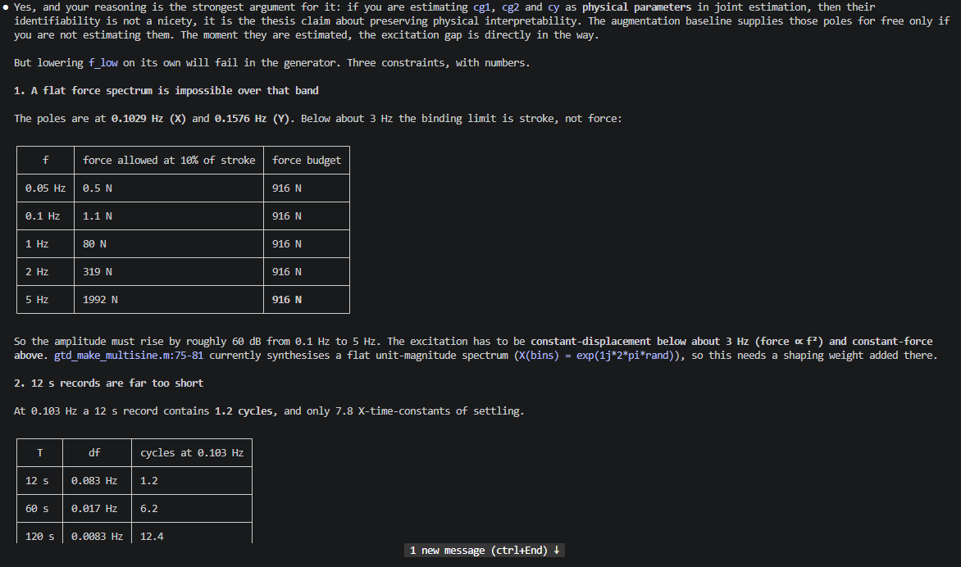
Need to discuss really slow dynamics for when we go into joint estimation.
60 s is the minimum, 120 s is comfortable. That is a 5x to 10x simulation cost per record.

Slide 89
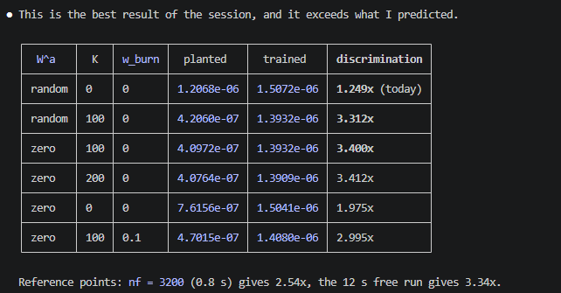

Slide 90
Controller each segment start at 0 justification??
But how does that work for the actual recorded
And the xc-at-segment-boundary question comes back, but for a better reason than horizon: if segments exist to carry a defect term, you still have to say what the controller state does at a boundary. With the segment starting from a re-encoded state, xc = 0 is arguably the consistent choice, since the whole segment is being treated as a fresh short experiment. That is now a question with a leaning rather than a coin flip.

Slide 91
Separate encoder error from ANN
So the two are complementary, not alternatives, and your instinct was right:
  - burn-in fixes the dynamics criterion: stop grading the ANN on an initialisation error it cannot fix.
  - the defect term fixes the encoder criterion: grade the encoder on agreeing with the dynamics.
Why 100. Two independent routes landed on the same number:- the loop's own settling time, about 20 ms from a 100 Hz crossover with 33.8 degrees of phase margin,- the burn-in sweep, where discrimination rises to 3.31x at K = 100 and then flattens: K = 200 gives 3.41x, essentially nothing more.
1. Does the encoder matter for the reported metric? Barely. 4.177e-07 from the encoder against 4.122e-07 from the true state, 1.3 %, because the loop suppresses x0 error over 12 s.

Slide 92
Why we still want a good encoder even within closed-loop
Which means the reason to train the encoder is not the score. It is that the deliverable is a state-space augmented model, and such a model needs a state estimator to be usable at all: for one-step prediction, for control design, and on real data where you cannot assume 12 s of loop suppression before the number is taken. An encoder frozen with Wa at zero would make the model score well and still be incomplete as an object.
1. Does the encoder matter for the reported metric? Barely. 4.177e-07 from the encoder against 4.122e-07 from the true state, 1.3 %, because the loop suppresses x0 error over 12 s.

Slide 93
Give Encoder it’s own learning rate
Separate gradient encoder and ANN??

Slide 94
ANN augmented states not learning
What about encoder?
Measured: rho(A_aa) = 0 at init, 2.9e-10 after training, against 0.976 for the model that works. The augmented states forget everything in 0.05 samples. They are states in name only, and gradient descent cannot build the dynamics because states that never reach the output receive no gradient. That is the 34.83x barrier, the orthogonal gradient, and the dL/dW^a = 0 all at once.

Slide 95
Revert interconnect
The revert is one command and touches nothing else. interconnect.py was clean at session start; today's diff is 70 insertions, 1 deletion, all of it the two terms:git checkout -- model_augmentation/fit_systems/interconnect.py

Slide 96
Controller effort for training
or reading the controller effort u_fb: which is the loop's own estimate of the model mismatch and is not suppressed the way the error is
  that second idea is in the residual-spectrum docstring and has never been used in training).
What it is mathematically. Since u_fb = C(z)·e, adding ||u_fb||^2 to the loss is exactly adding a frequency-weighted copy of the output error, weight |C(jw)|^2. That weighting does one specific thing: it undoes the loop's suppression. Below crossover the tracking error understates the true model error by the sensitivity (e = S·d), while the effort restores it (u_fb = C·S·d, and |CS| ≈ |P^{-1}| at low frequency, which is large). So the effort term makes the loss see low-frequency model error that the tracking error hides.

Slide 97
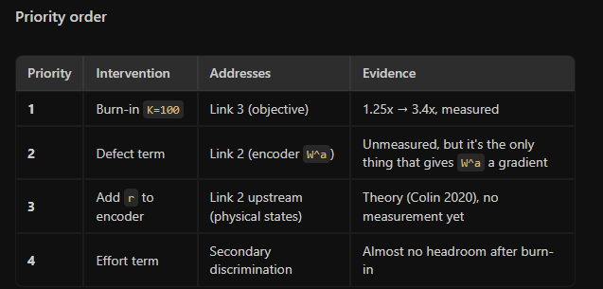
Implementation order

Slide 98
Currently use observability for input output Jan’s method
Don’t use r for closed-loop now
What the theory actually says
The SUBNET encoder theory (Beintema, Automatica 2023): Assumes open-loop data. The encoder approximates the reconstructability map ψ: (u_past, y_past) → x. Under observability, this map exists and (u, y) history uniquely determines the state. This holds in closed loop too — observability is a system property, not an input property. So theoretically, (u, y) alone is sufficient to reconstruct the state even in closed loop. Adding r is not required by observability.
The informativity theory (Colin 2020, from the sweep): Shows that r provides a second discrimination channel for the identification objective, not for the encoder. The two channels are: (1) controller-kernel, and (2) reference-excited input. This is about whether the loss can distinguish correct from incorrect models, not about whether the encoder can reconstruct the state.
Kessels (thesis ch. 5): Adds r and e as encoder inputs as a practical design choice. He doesn't derive it from encoder theory or prove it's necessary. No theorem, just engineering.

Slide 99
Same controller only y reference?
closed_loop_rollout computes u_plant = u_data + C_fb(y_data - y_model). Sugie and Maruta's Fig. 6 drives the model with u + K(y - ŷ). Same estimator. Their Section 3 derives it from dual Youla and shows the two are equivalent when K̂ = K, which is why they recommend it: you keep the plant itself, so you keep theta_base, integrator-type prior knowledge, and interpretability, and you never touch a coprime factorisation.

Slide 100
1. Representation. Can the wiring even express a useful augmented mode? Cd_norm has zero columns on the augmented states (model.py:242-244), so x_a reaches y only through the ANN's correction on physical rows 0-5. Every improvement you have measured so far went through that same path as a static function of (x, u). Nobody has shown the dynamic route can carry anything at all.2. Recoverability. Given it is representable, can gradients find it from the residual?3. Estimation. Can the encoder initialise x_a well enough for a 400-step rollout (P4, P5, §4.3)?4. Optimization and objective. Does the loss actually reward keeping the mode (P3)?5. Capacity. Is one resonator too few (P6)?

Slide 101
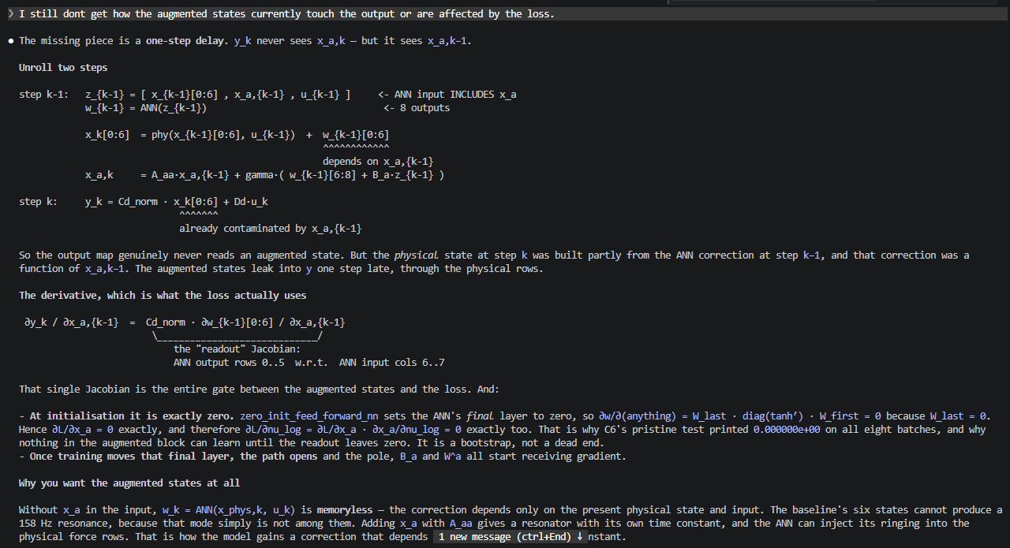
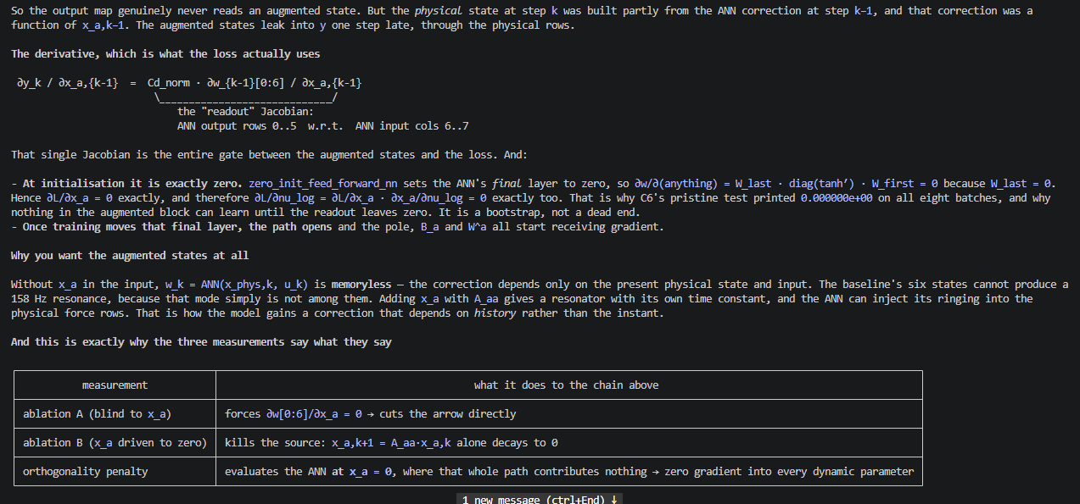
How does do the augmented states touch the loss and output?
x_a,k = A_aa·x_a,{k-1} + gamma·( w_{k-1}[6:8] + B_a·z_{k-1} )

Slide 102
BLA of the residual!!!
If that works is much more defensible, than the current implementation!!
BLA of the residual — estimate a linear model from u to r = y − y_baseline. Its poles are the missing dynamics, directly. This is Ljung's Model Error Model, and it is the same object our band recipe is groping at with a PSD and a peak-picker.So: BLA of the residual.
One opportunity: the mode moves with Y (f(Y) = −12.0 Y + 156.4 Hz, R² 0.566 on the four validation records). A BLA per Y operating point is the standard LPV local approach, and it would put the augmented dynamics' Y-dependence on the same footing as the baseline's. That sits directly on the thesis contribution rather than beside it.

Slide 103
Random weights or use BLA… for augmented states
In schoukens2020lfr and schoukens2021ssnn_init the known part is fitted to the data. Their BLA therefore already contains whatever linear dynamics the system has, including ones the modeller never anticipated. The added block only has to supply nonlinearity, and claim 4 is exactly the argument that random hidden weights suffice for that: they "generate a pool of nonlinearly transformed outputs which the estimator can pick from".

Slide 104
BLA init justification
Decision | Literature support | Limitation
Estimate a closed-loop BLA through G_yr G_ur^-1 | Pintelon, M. Schoukens and Lataire (2020), DOI 10.1109/TIM.2020.2987476 | Does not justify an incorrect baseline or arbitrary production excitation
Model finite-record transients during nonparametric BLA estimation | Relan et al. (2017), DOI 10.1109/LCSYS.2017.2712364 | Requires suitable excitation and frequency-line conditions
Use a linear approximation to initialize a nonlinear state-space model | Schoukens (2021), Improved Initialization of State-Space Artificial Neural Networks | Does not prescribe this particular added-state architecture or pole-selection procedure
Use residual learning alongside a physics model | Bolderman, Lazar and Butler (2022) | Their parallel correction is not this exact dynamic augmentation
Use a state-dynamic parallel LFR augmentation | Hoekstra et al. augmentation framework | Does not specify BLA-derived poles or prove their physical interpretation
Refine linear and nonlinear components after initialization | Marconato et al. (2014) | Joint refinement can destroy physical-parameter identifiability
Stable eigenvalue parameterization and normalized recurrent input paths | Orvieto et al. (2023) | LRU initialization theory does not establish BLA pole selection
The sources justify individual steps. No source establishes the complete pipeline:
incorrect physical baseline → residual BLA → selected modal pair → ANN augmentation → joint physical-parameter training.

Slide 105
sunday

Slide 106
Yes, if “no initializer” means no BLA, no data-derived band, and no accurate pole placement. That is plausible but not yet demonstrated.
The minimal defensible change is Jan’s framework plus:
a live random input path \(B_u\), otherwise the augmented states remain dead;
four distinct stable pole pairs drawn from Orvieto’s full-disk distribution, providing memory and span.
Those are generic, published initializations, not data-informed initialization. Plain Jan with neither addition is not expected to reach e-7: its augmented states are identically dead, measured by the 1.0002x ablation.
So my current verdict is:
Plain Jan unchanged: no.
Jan plus a generic citable LRU recurrence and excitation: probably yes.
Proven already: only with the data-derived band, at \(3.795974\times10^{-7}\) and 5.21x ablation.
Still requiring the server campaign: whether the generic full-disk draw reproduces that result.

Slide 107
but why in jan his examples in msd ecc, bouc wen, and another one. Is this not needed?Correct, it isn't needed there, and that's the right thing to press on. Jan's ECC MSD has the same structure we call dead: msd_ndof_interconnect_dynamic.py:86 is Static_ANN_Block(net=zero_init_feed_forward_nn) with nw = nxd writing all rows, augmented states excited only by the encoder's W^a at each window start. No B_u, no pole draw. And it works.So the framework isn't the problem. What differs is the size and shape of what the augmentation has to find.1. Relative magnitude. Untrained pooled error here is 2.19e-06 m against Y motion of order 3e-2 m, so the augmentation is chasing about 7e-5 of the signal. In Bouc-Wen and cascaded tanks the unmodelled part is a percent-level or larger fraction of the output. A zero-init ANN gets a gradient proportional to what is missing, and here that gradient is four decades down.2. There is a large easy residual that soaks it up first. Arm 1 improved 36.89 % with an ablation of 1.02x, i.e. entirely through the static physical rows. Jan's benchmarks have no comparable free lunch, so their augmented states have to earn their keep from step one. Ours can be ignored and the loss still drops.3. Q. The target is a tuned absorber, zeta_a = 0.05 at 157.89 Hz, half-power width 16.7 Hz. Bouc-Wen hysteresis and tank saturation are broadband, low-order nonlinearities: reachable by gradient descent from zero. Building a r = 0.987 pole from zero is not, and C6 measures the objective pushing r the wrong way even when handed the correct pole.4. Horizon. In Jan's examples the encoder re-initialises x_a[0] every window, and nf = 200 is short enough that an initial condition is real excitation. Our acceptance metric is a 48000-sample free run where x_a[0] has long since decayed, so encoder excitation that suffices for his scoring surface does not survive ours.Caveat on what I've actually checked: (1) and (2) are numbers from this repo, (3) is from gtd_config.m plus C6, (4) is structural. I have not read the Bouc-Wen or cascaded-tanks scripts, so their residual fractions are my inference, not a measurement.If you want that inference turned into a fact, the cheap check is the unmodelled-fraction ratio for each benchmark. It's a few minutes and it would tell you whether "our problem is 4 decades harder" is real or an excuse.

Slide 108
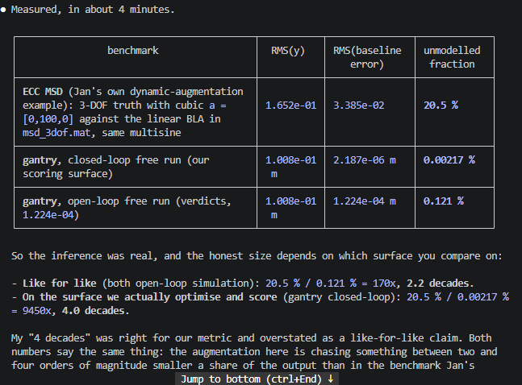
Data order of magnitude

Slide 109
Based on [tasks/overnight-2026-08-21-verdicts.md](C:/Users/20203253/OneDrive - TU Eindhoven/Graduation Project/Baseline FP model/Baseline-LPV-Augmentation/tasks/overnight-2026-08-21-verdicts.md)
We know what makes it work right? What the cause of this one training. The failures are also clearly documented.
Is it due to lack of gradient? Can you explain in short to me what the actual problem is?

Slide 110
problem
- Not representation. C2: planted physics reaches 4.176627e-07 with a 6.010x ablation on this data.- Not the encoder. C8: gap 0.997x against a 2.0x boundary.- Not the data. Arm 2 actually trained to 3.795974e-07 on it.- Not the metric. We just measured |So| = 1.81 at 157.89 Hz; the loop amplifies the band it needs to learn.The actual problem, in one sentenceThe augmented poles are frozen by the objective, so they must be placed rather than learned, and Jan's framework has no mechanism either to place them or to excite the states they live in.
- B_u: turns a zero-gradient saddle into a trainable path.- A_aa near the unit circle: gives x_a memory, so it is not a delayed copy of z.

Slide 111
PROBLEM with augmented states training!!!
1. B_u, a live linear input path at init.Plain Jan writes x_a only through the ANN, whose output is zero at init, so x_a = 0 for every k. That is an exact saddle: the ANN's read weights on x_a see an all-zero input so their gradient is zero, and writing x_a changes nothing downstream because nothing reads it. Flat in both directions, so it never starts. Measured: 1.0002x, F = 0.0007.Gives: a nonzero gradient. Without it nothing else matters.2. A_aa with |lambda| near 1.With B_u but no recurrence, x_a[k+1] = B_u z[k] is a one-sample delayed combination of z = [x, u], which the ANN already reads at step k. You have duplicated what it has. The target rings for 19 ms at 157.9 Hz; only a pole near the unit circle holds that.Gives: memory, so x_a carries something new.3. Poles placed in the right band, and more than one.The objective freezes them: with the true mode planted, dL/d(nu_log) < 0 on 7 of 8 batches, T3 proves no reweighting flips that sign, and measured pole motion is under 0.15 Hz over 520 updates. So whatever you install is what you keep, and the block is a fixed basis, not a resonator. One pole 3.35 Hz off the mode gives 1.02x (arm 1); four spanning 151.9-162.9 Hz give 5.21x, F = 0.88 (arm 2). A nx_aug = 2 control with more ANN parameters (828 vs 798) lands on arm 1, so this is basis directions, not network size.Gives: a basis the frozen block can actually represent the mode with.
Steps 1 and 2 are not heuristic and they do extend. B_u live at init is Hoekstra p10 (matrices not pinned by baseline equality are U(-1,1)) plus Bachlechner's live-branch-behind-a-zero-gate. |lambda| near 1 is Orvieto §3.3 verbatim. Neither uses any knowledge of the plant, and both transfer to Telica unchanged. They are cited and setup-agnostic. Step 3 is where you are right. Every non-identification option leaks knowledge or fails: - band recipe: ad-hoc peak-picking on an artefact, unpublished, does not generalise. - band-spread on [130,180]: we chose that band around fa = 150 Hz. Oracle, and it needs the band known in advance, which on an unknown setup it is not. - full disk / Ring Init: genuinely literature (Orvieto), not heuristic, but measured to place nothing useful here. Citable and ineffective, which is its own kind of dead end. So the only step-3 option that is both cited and transferable is identify the residual, place the poles where the identification says. That is the category you are pointing at and it is the right one.
schoukens2021_improved-init-state-space-ANN_ECC, Maarten Schoukens, sole author. Abstract, extracted:▎ "This paper introduces an improved initialization approach for nonlinear state-space models represented as a recurrent artificial neural network and emphasizes the importance of including an explicit linear term in the model structure. Some of the neural network weights are initialized starting from a linear approximation of the nonlinear system, while others are initialized using random values or zeros."

Slide 112
Superposition is applied to Cfb alone.
▎ Let F be any causal operator: linear, nonlinear, LPV, a neural network, a lookup table. Let Cfb be linear. Then, for consistent controller states,▎ Cfb(r - y_m) = Cfb(r - y_d) + Cfb(y_d - y_m)▎ and therefore u_m = u_d + Cfb(y_d - y_m).
The objection is the conflation of "the loop is nonlinear" with "the operator I applied superposition to is nonlinear." The loop is indeed nonlinear. The controller is not, and the controller is the only thing being manipulated.

Slide 113
Direct least squares in closed loop is biased only when noise is correlated with the input through the loop. This is a noiseless simulation: r = y - y_baseline is deterministic model mismatch, not a noise realisation, so that mechanism is absent and the direct method is consistent. That is why the logged-u fit lands within 0.014 %, and it is measured rather than argued.

Slide 114


